Slide 1
An NSS Audio-Visual
Library Presentation
Speleothems
Dr. George W. Moore
S301 71 Slides 2/03/2021
Notes:
“Speleothems,” by Doctor George W. Moore. NSS member George Moore is an outstanding geologist and mineralogist. Dr. Moore has expended great effort and time in putting together this Series Number 6 Slide-Lecture for the National Speleological Society’s Visual Aid Service. Many of these outstandingly fine slides have been donated to this series by various NSS members; others are from Dr. Moore’s own photographic collection.

Slide 2
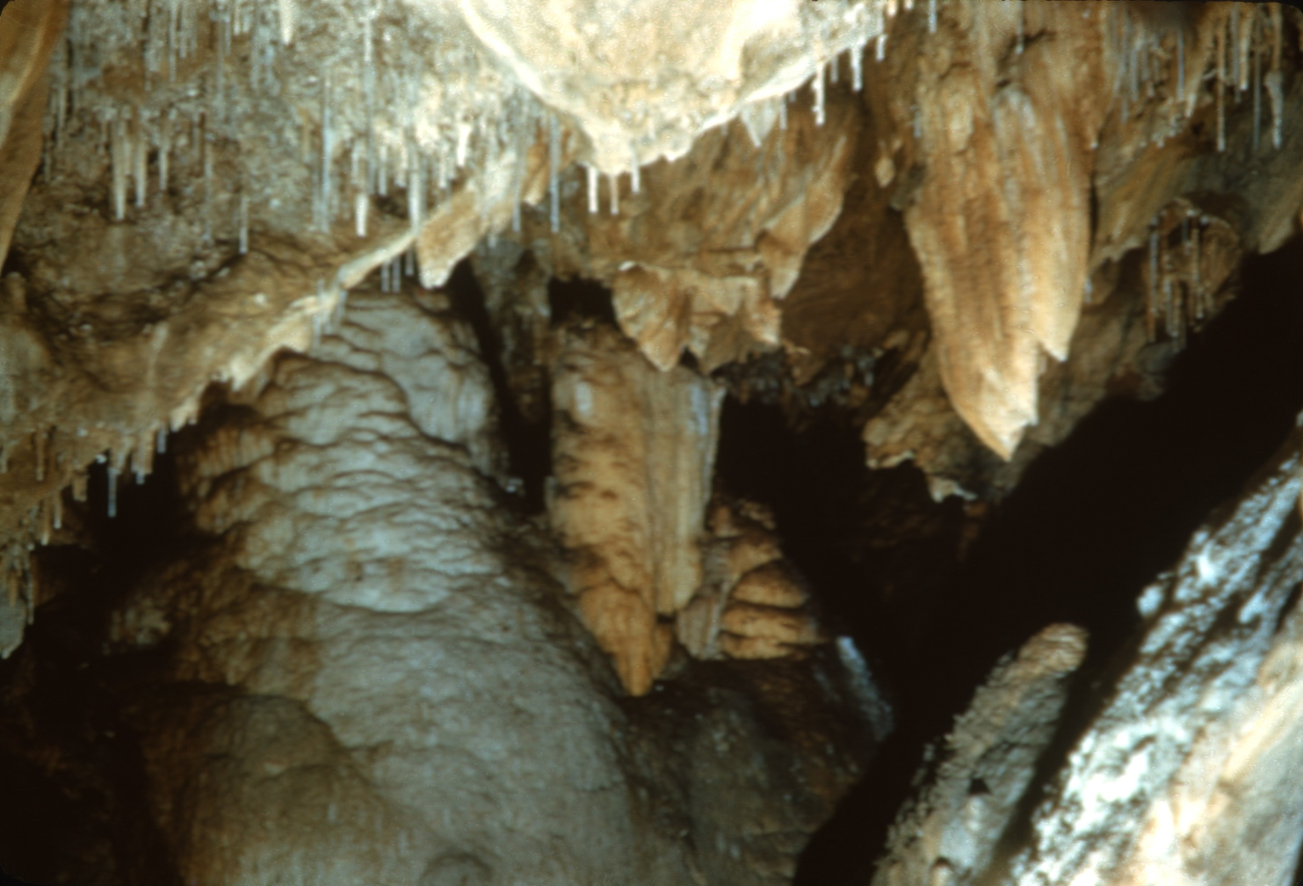
Notes:
Mineral deposits in caves are called SPELEOTHEMS. The term is applied only to deposits formed from solution or by the solidification of a fluid after the formation of the cave. Hence, stalactites, together with ice crystals formed directly from water vapor in a cave, are speleothems, while beds of clay fill, and calcite veins made to stand in relief when the walls of a cave are dissolved, are not speleothems.

Slide 3
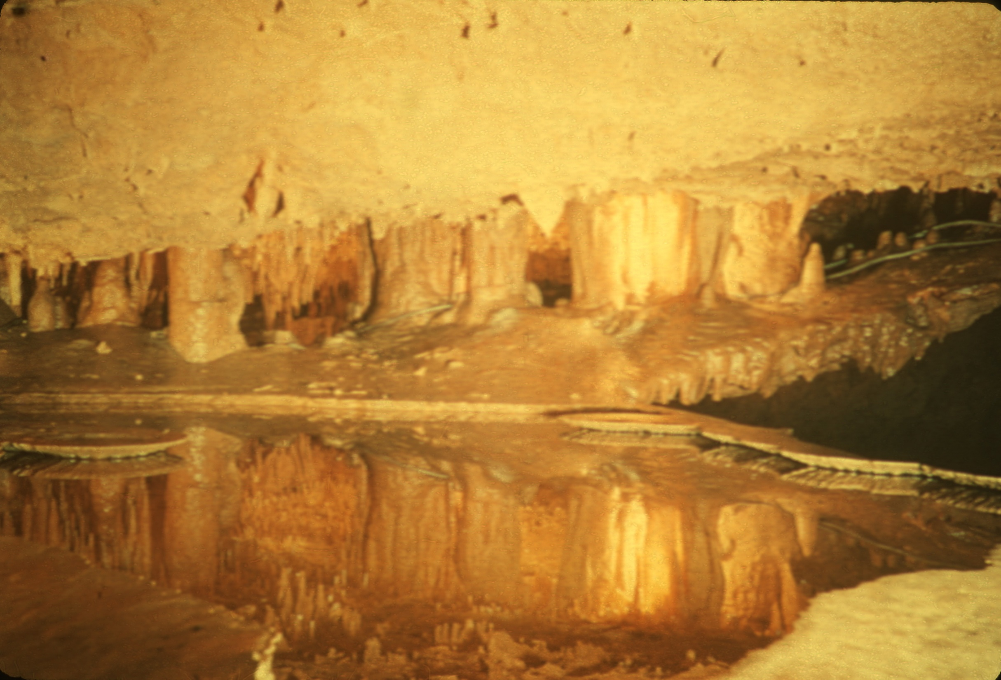
Notes:
The processes by which cave minerals are deposited operate in three environments: (a) minerals are formed in the air-filled parts of caves, (b) they are formed on the surface of cave pools, and (c) they are formed underwater in those pools.

Slide 4
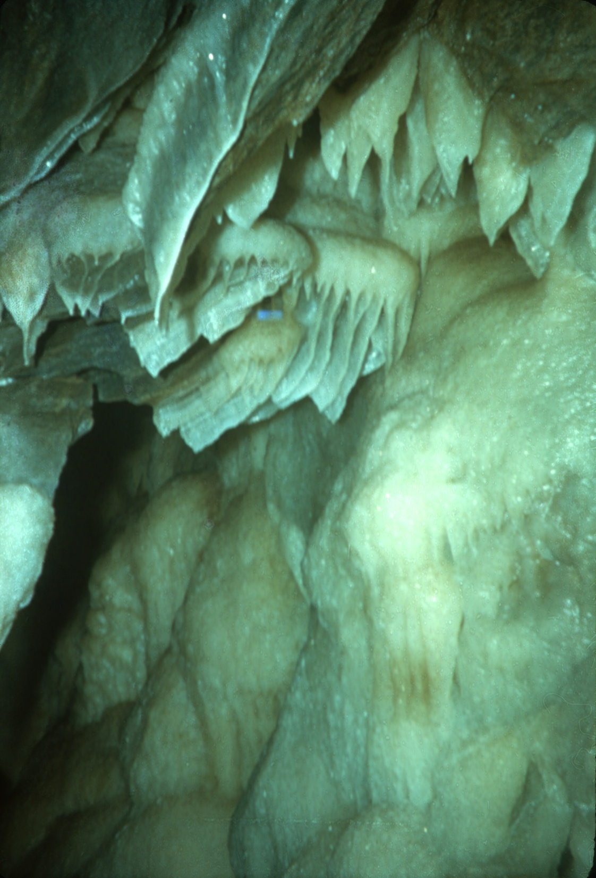
Notes:
The most common speleothems form in the air-filled parts of caves—on the walls, ceiling, and the floor. They are deposited in four ways: 1. by dripping water, 2. by flowing water, 3. by seeping water, and 4. by condensing vapor.

Slide 5
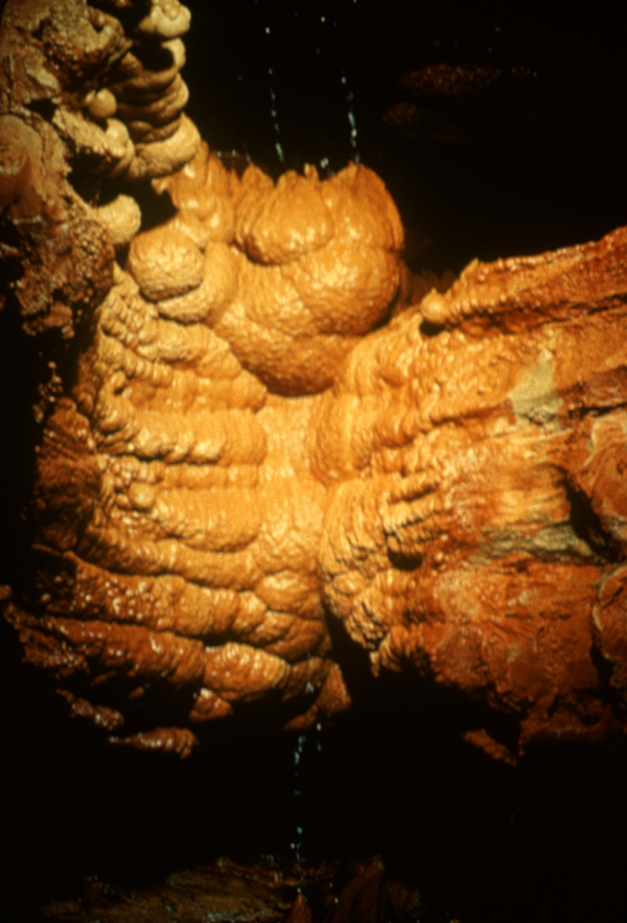
Notes:
Cave deposits formed by dripping water are familiar to everyone. The shape of the drop itself, and the effect of gravity on the drop before it falls, determine the shape of these structures.

Slide 6
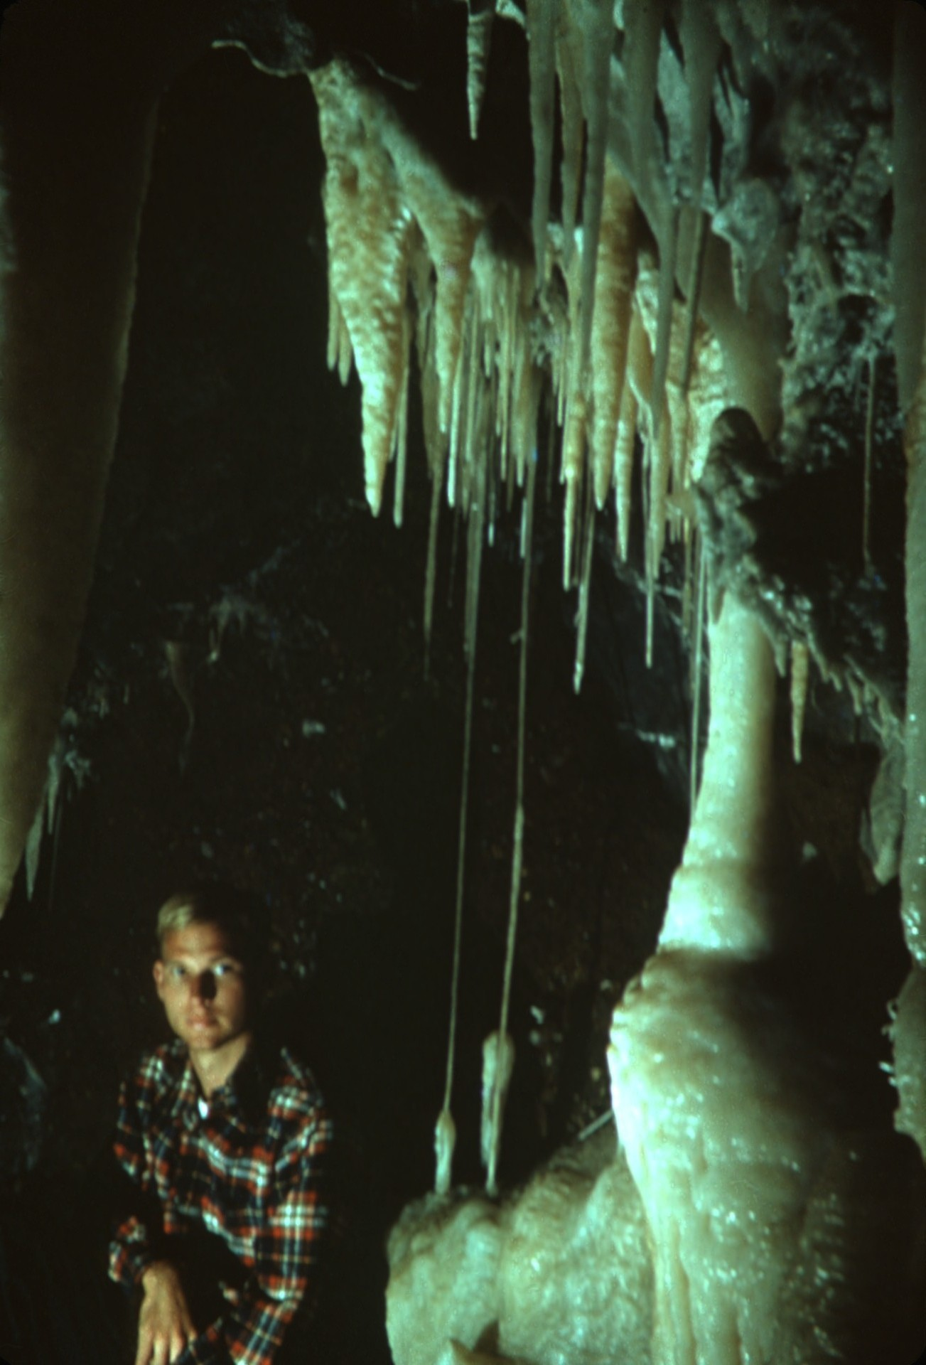
Notes:
STALACTITES, pendant deposits that hang from the ceiling of nearly every cave, are formed in this way. A drop of water issuing from a crack in the ceiling of a cave is pulled downward by gravity and hangs from its point of attachment. Because the drop is in contact with the ceiling only at the top, deposition can occur only at this point.

Slide 7
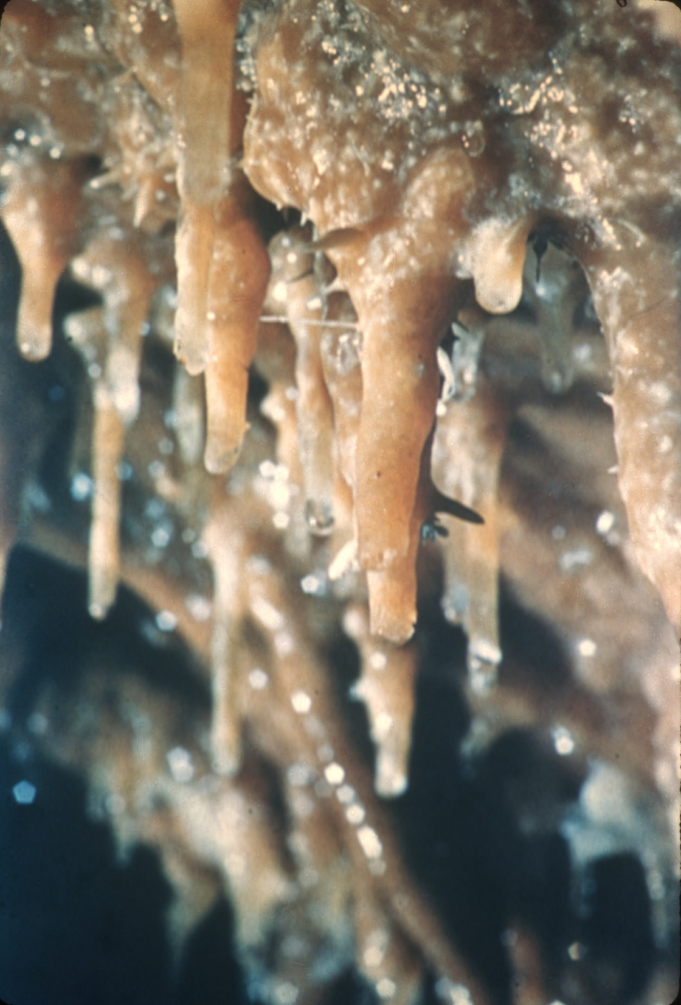
Notes:
As the drop enters the chamber, it is relieved of pressure under which it was confined in the wall of the cave. When this pressure is released, carbon dioxide is given off, causing calcium carbonate to be deposited. Since the loss of carbon dioxide occurs from the surface of the drop of water, deposition is favored on the surface. Calcite is laid down as a ring where the surface of the drop intersects the rock of the ceiling. As drop after drop issues from the crack, ring is added onto ring until the deposit forms a hollow cylinder with the diameter of a drop of water hanging from the ceiling. The water continues to move from the crack down through the central hollow of his slender straw-shaped cylinder to its tip, each time adding a small increment of length to the tip of the stalactite. The result is a TUBULAR STALACTITE, or soda straw.

Slide 8
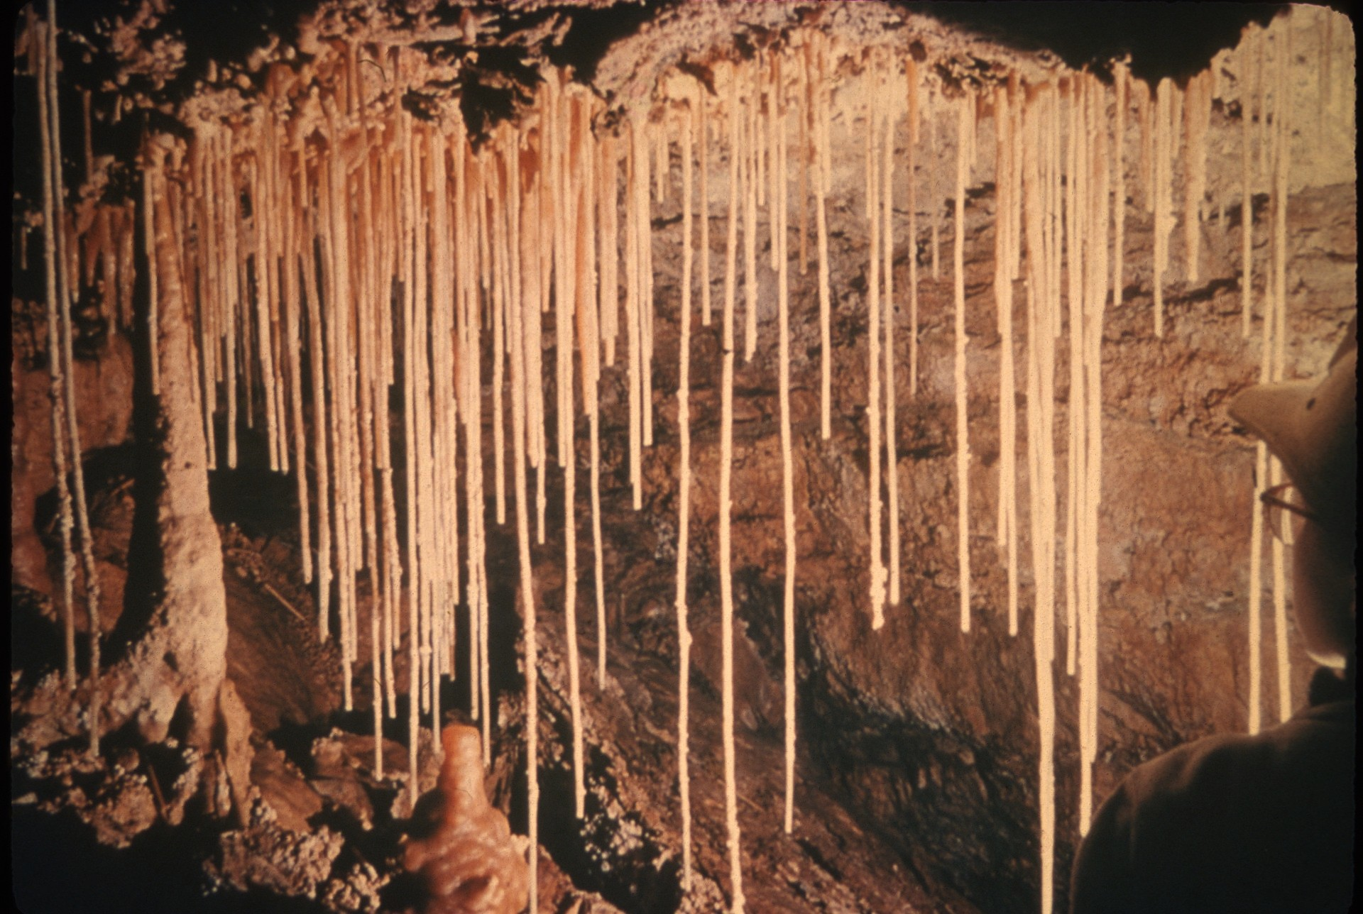
Notes:
Tubular stalactites are common in caves. They average about a quarter of an inch in diameter and may be as long as a yard or more. Their thin walls are only about a sixty-fourth of an inch thick.

Slide 9
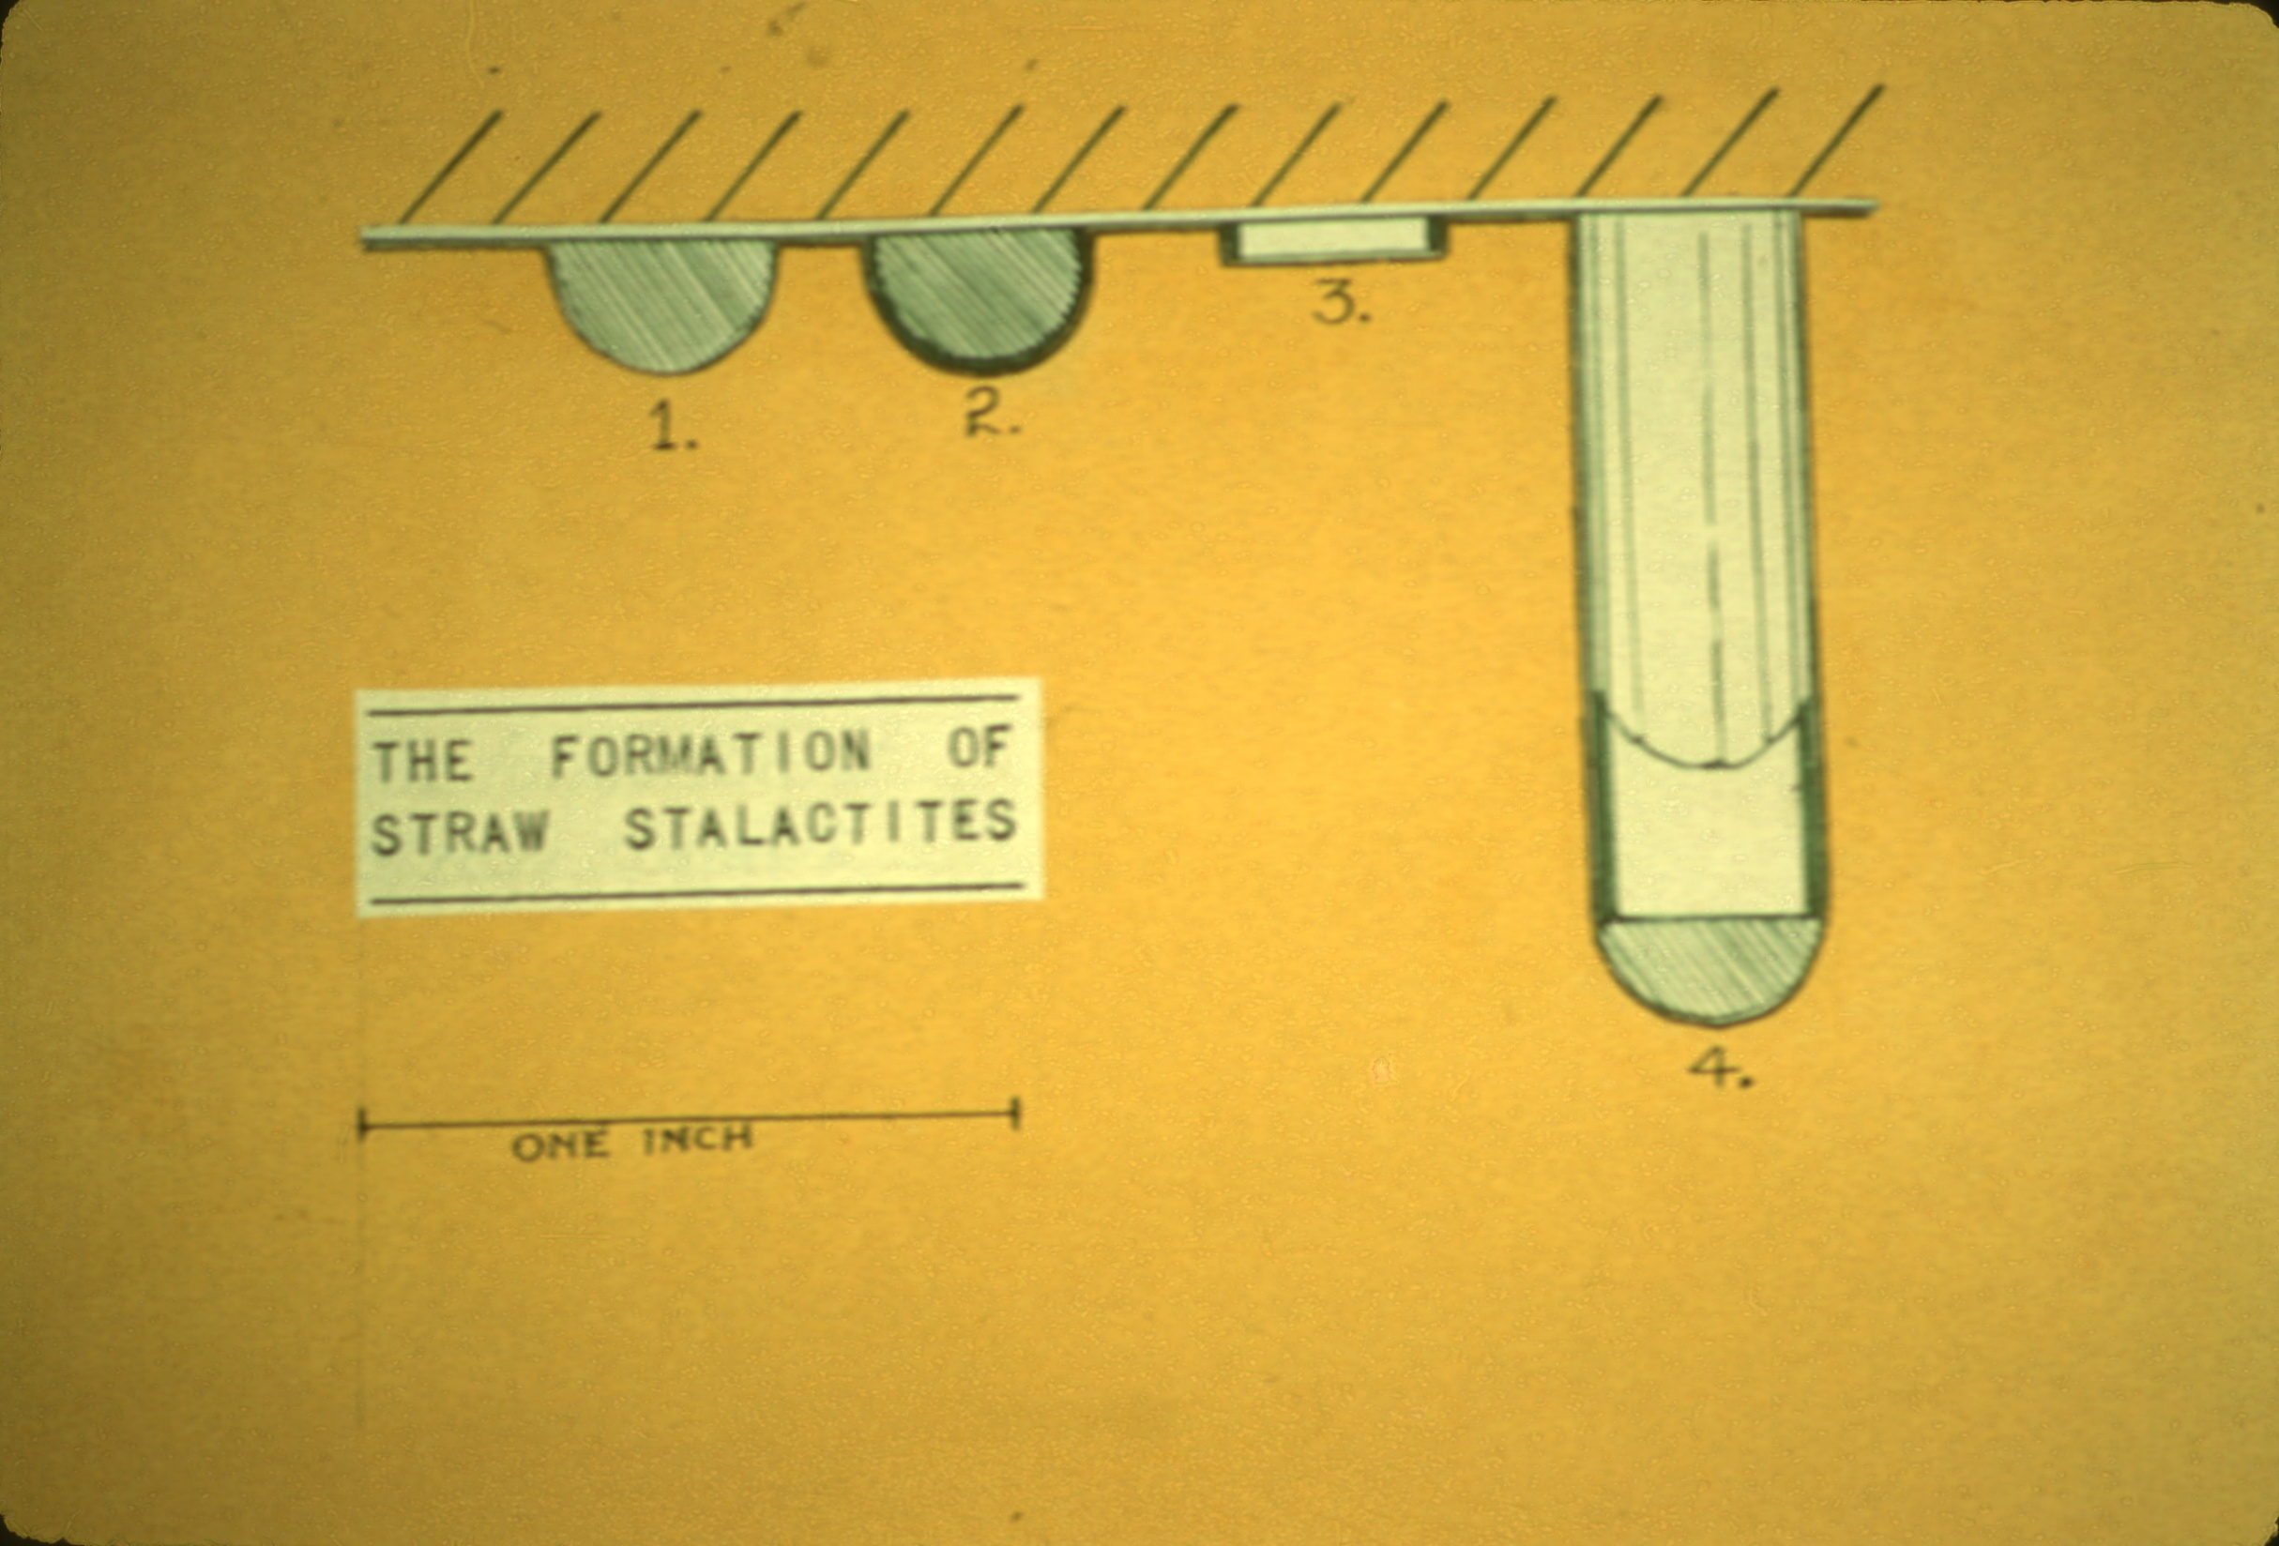
Notes:
The crystal structure of tubular stalactites is simple. They are generally composed of nearly pure calcite and, in spite of their tubular shape, are a single crystal. Each time a new bit of length is added to the tube, the molecules arrange themselves in precise order following the pattern laid down during deposition of the previous layer. The result is a structure exactly the same as one that would be obtained if the tube were cut from a large calcite crystal. As a result of this internal structure, if a tubular stalactite is broken, fracture will occur along a smooth diagonal cleavage.

Slide 10
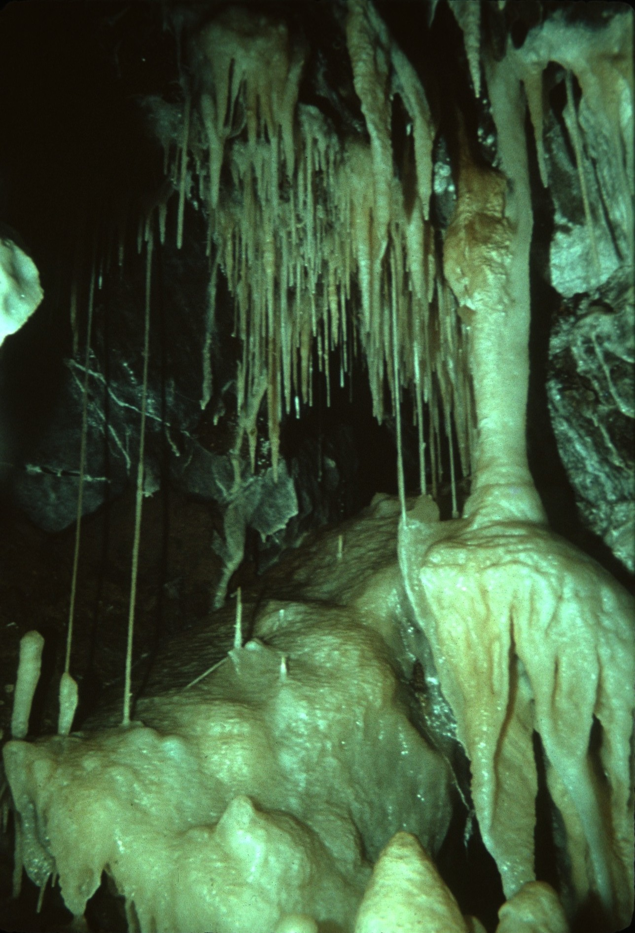
Notes:
Tubular stalactites are very fragile, and sometimes they break naturally of their own weight or as a result of earth tremors. Commonly, there may be a pile of broken stalactites below a group of these slender forms, and sometimes the broken ones are cemented to deposits below.

Slide 11
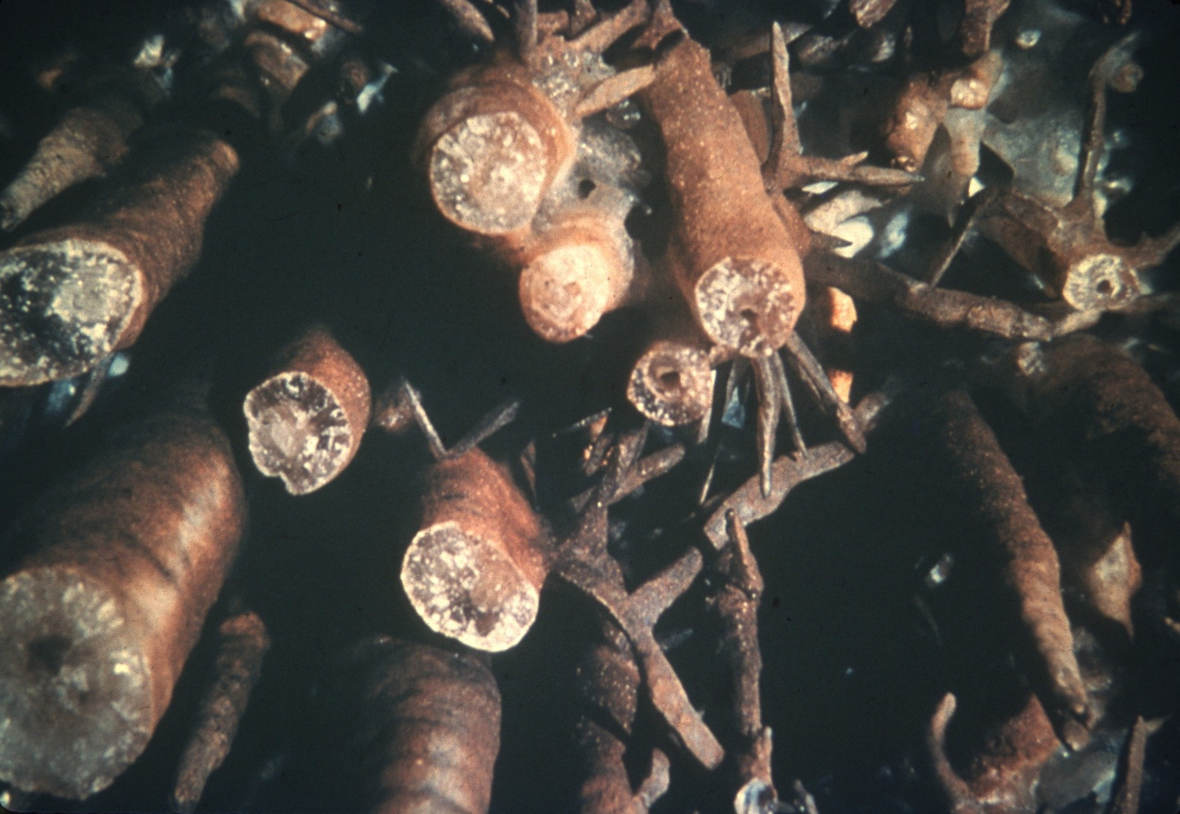
Notes:
Even though most stalactites are conical, and many are very massive, they had their origin as delicate tubular stalactites. Evidence of this early history can be found in broken specimens in the form of a narrow central canal or a zone of clear calcite about a quarter of an inch in diameter, representing a tube that has been filled.

Slide 12
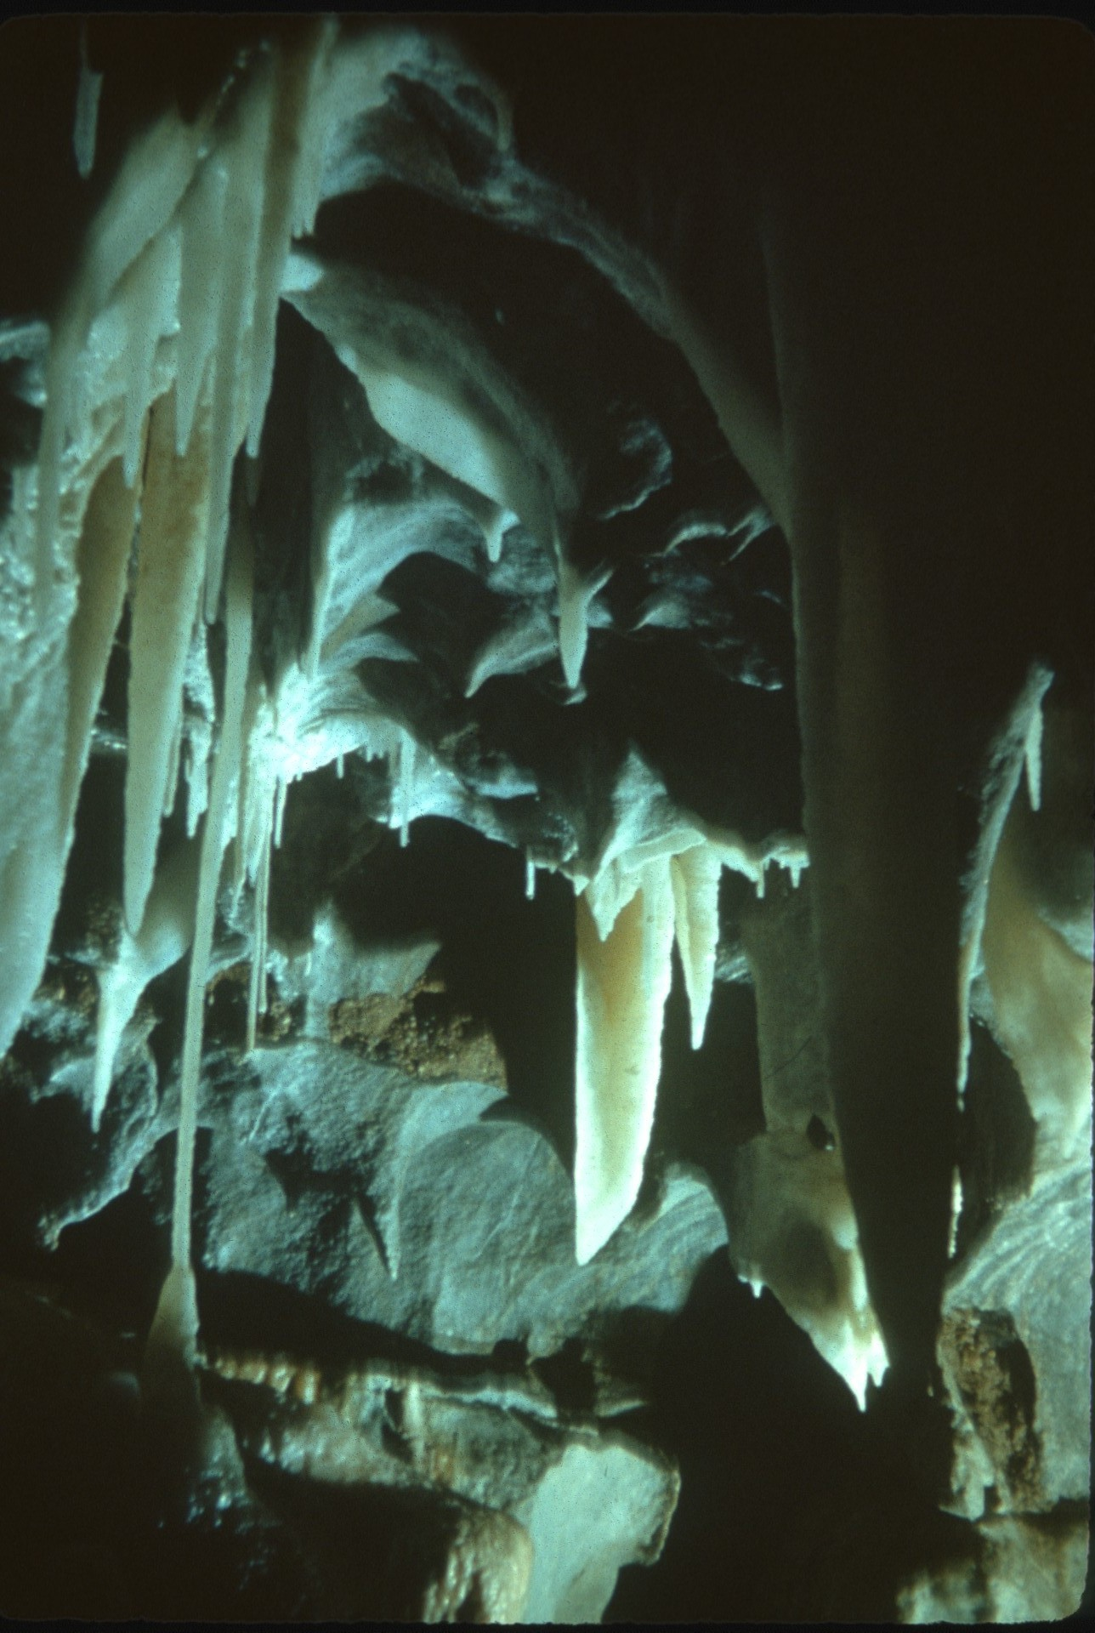
Notes:
Stalactites in caves grow very slowly. Many people have written of stalactites which have grown on concrete or mortar and have noted rates of growth as much as several inches per year. The rate of growth of stalactites in these environments, however, bears little relation to that of stalactites in caves. Through cement and mortar are made from limestone, the same rock in which caves occur, the limestone has been altered by roasting, and carbon dioxide has been driven off. When water is added to these materials, calcium hydroxide is produced, along with other products. Calcium hydroxide is 100 times more soluble than calcium carbonate and may react rapidly with carbon dioxide from the atmosphere to produce stalactites. Hence, stalactites formed by solutions from cement and mortar grow at an entirely different rate from stalactites in caves.

Slide 13
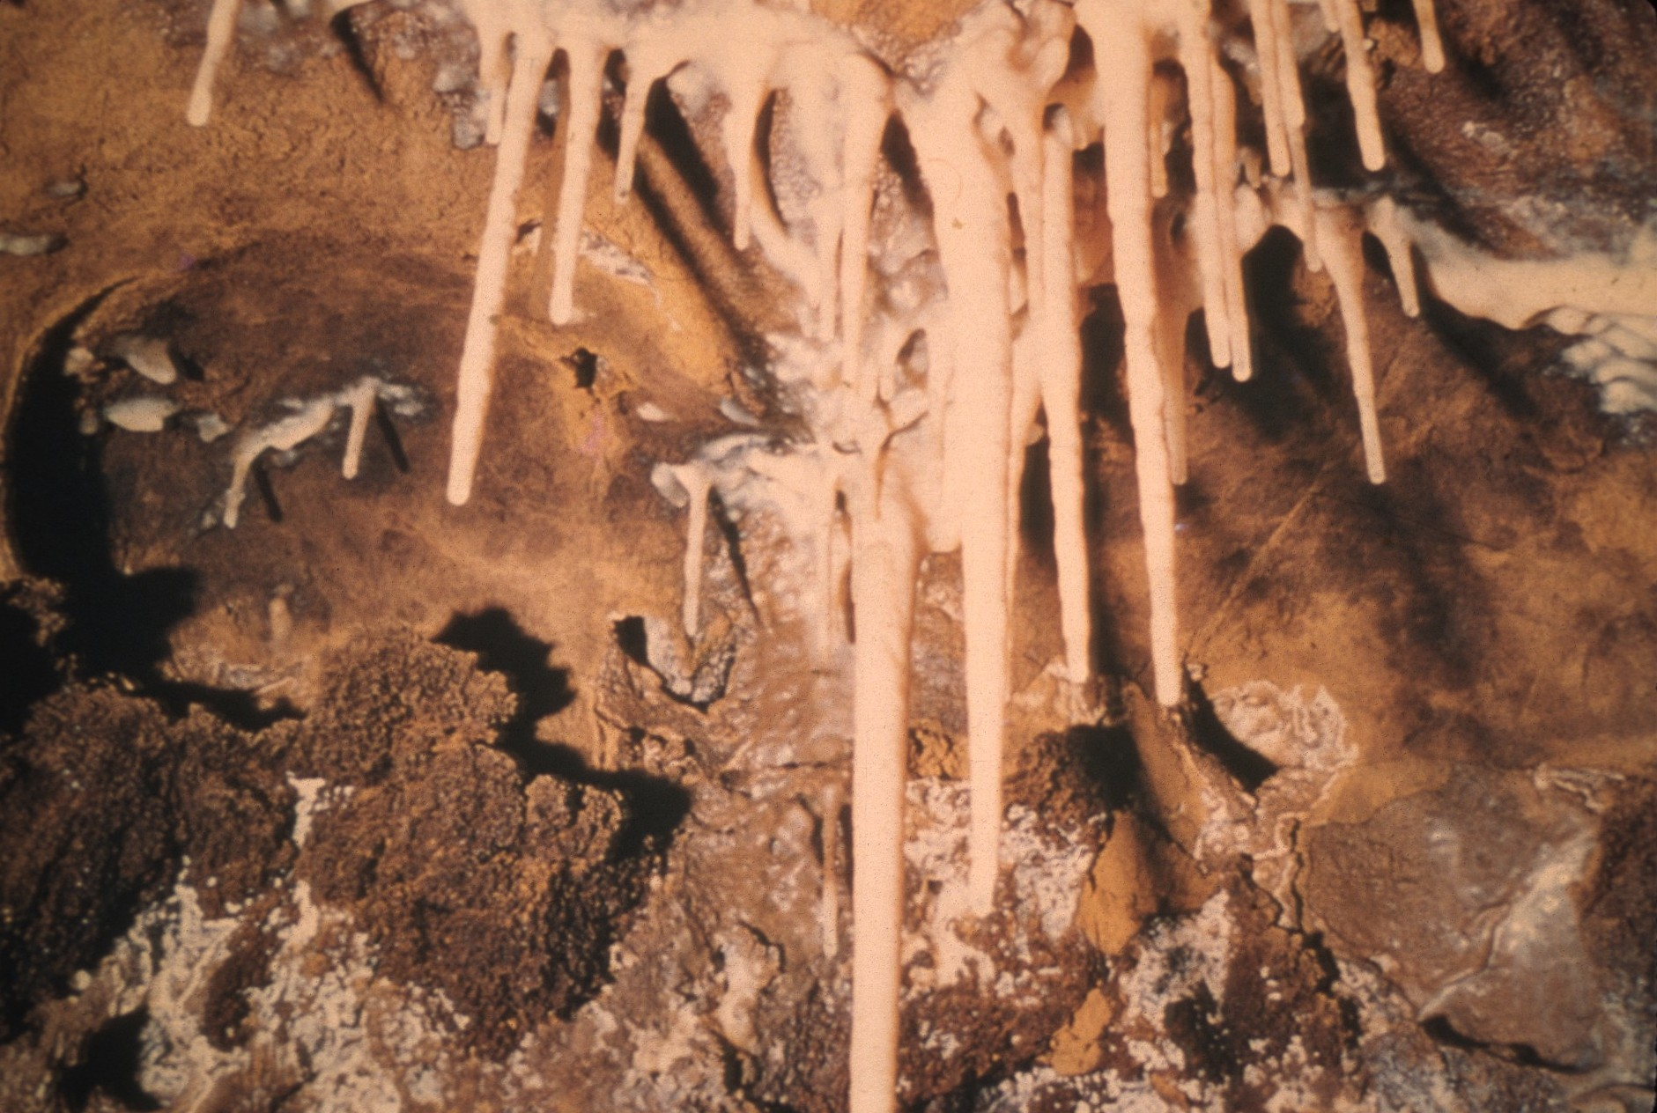
Notes:
The best way to learn the true rate of growth of stalactites is to make measurement in caves over a period of years. Several measurement of this type have been made. The rate of growth is variable, but probably never much exceeds a tenth of an inch a year and may average about a hundredth of an inch.

Slide 14
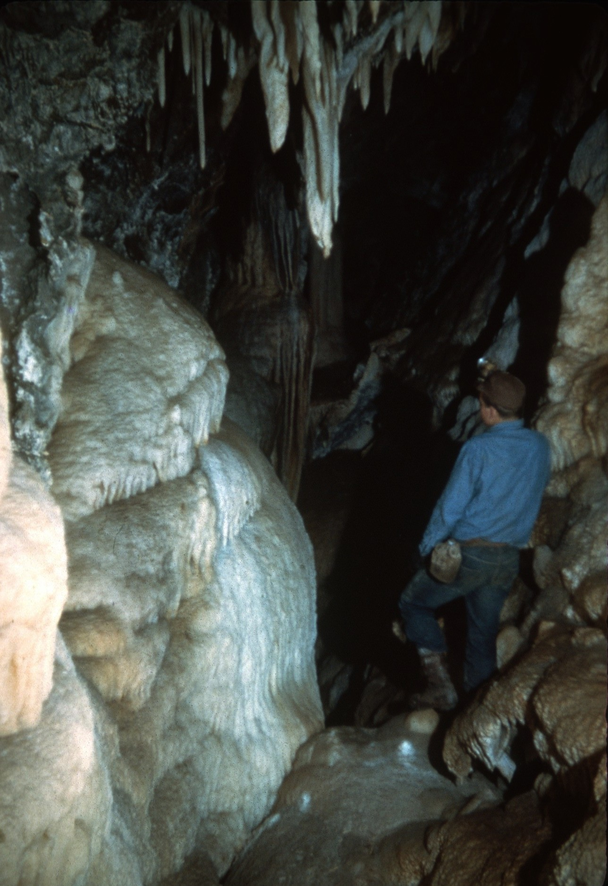
Notes:
Cave deposits formed by flowing water in the air-filled parts of caves are much more abundant than all other speleothems combined. Many caves contain tons of this material, and some have nearly been filled by it.

Slide 15
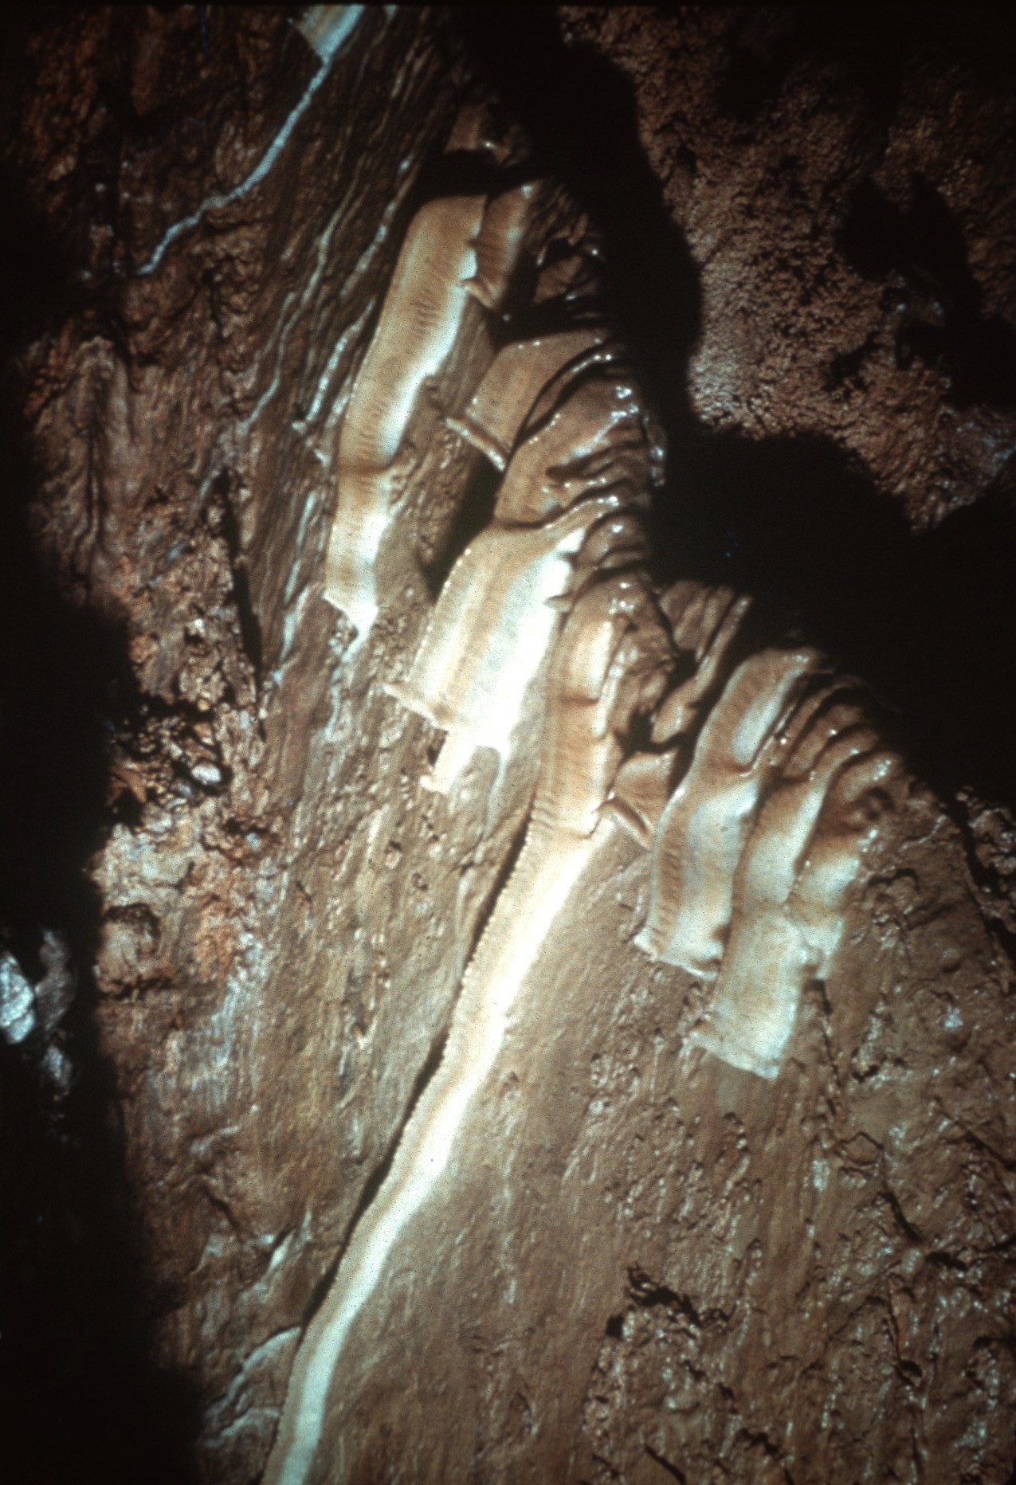
Notes:
A type of speleothem that owes its shape mostly to flowing water and in part to gravity pulling a drop of water downward is the DRAPERY. Draperies are think translucent sheets of travertine that hang from the ceilings of caves.

Slide 16
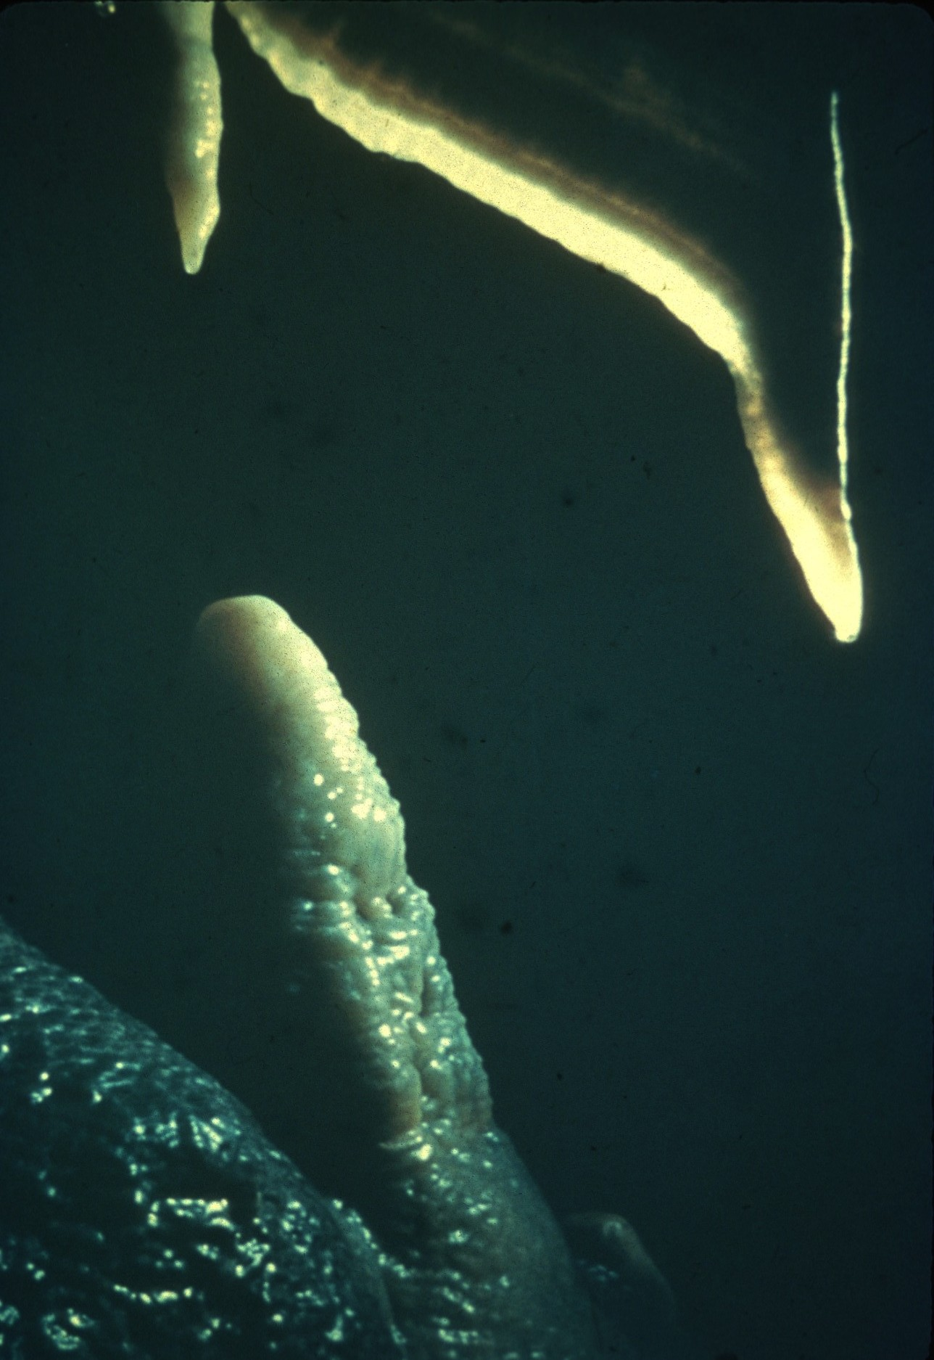
Notes:
During certain periods in the growth of draperies, impurities in the water may leave orange or brown streaks. These impurities give the deposit a banded structure that somewhat resembles the appearance of sliced bacon.

Slide 17
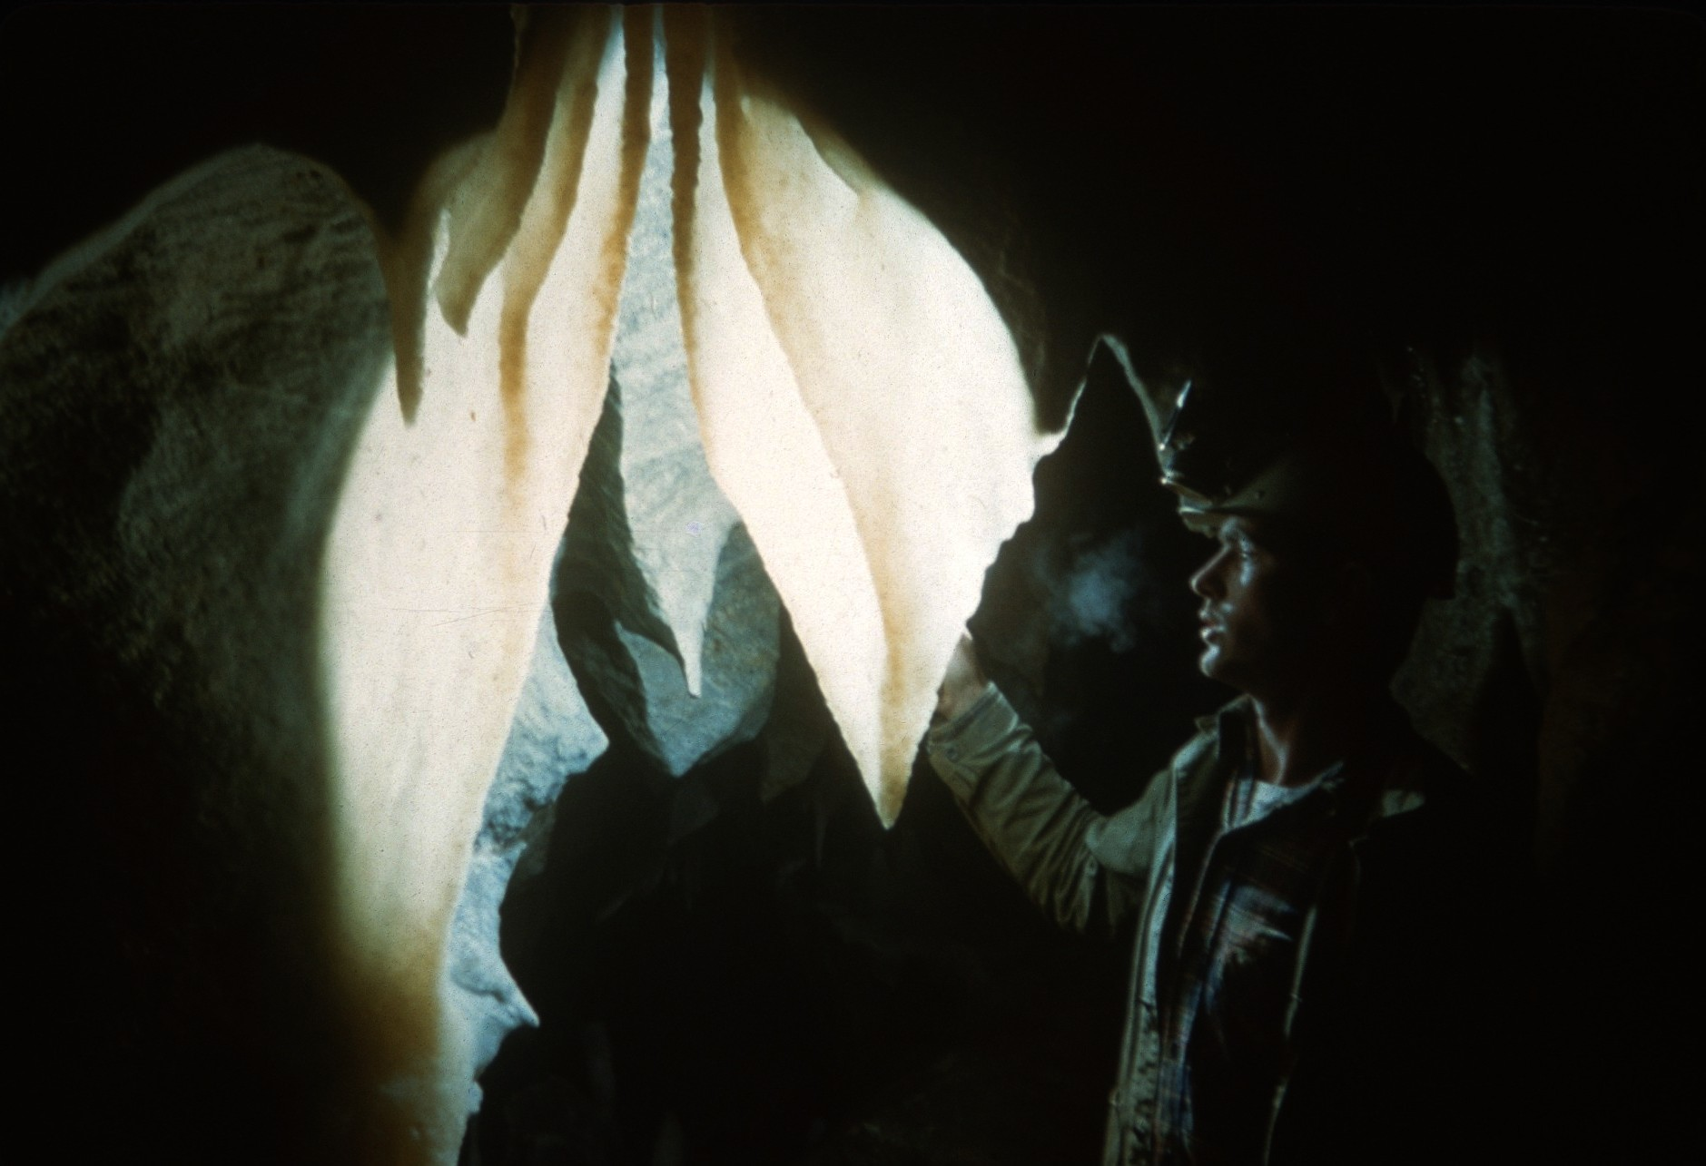
Notes:
When they are first formed, draperies are about a quarter of an inch thick, though they may be thickened by later deposition. In some caves, they have grown downward as much as ten feet or more.

Slide 18
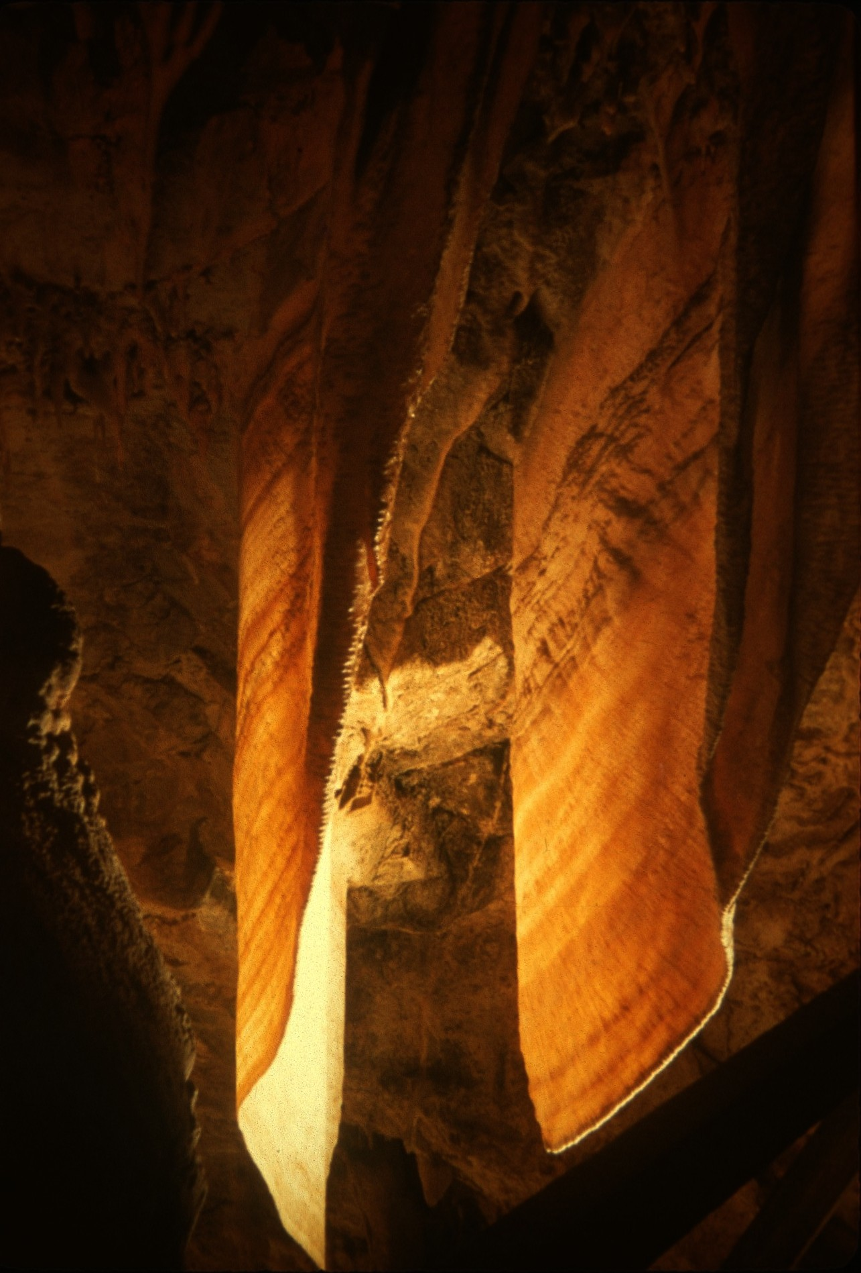
Notes:
Draperies of calcite are made up of long, slender crystals perpendicular to the surface of growth. These crystals may be several inches or more long, as thick as the drapery, and about a quarter of an inch wide along the edge of the drapery. As each new layer is laid down, the molecules follow the orientation of the crystals of the last layer.

Slide 19
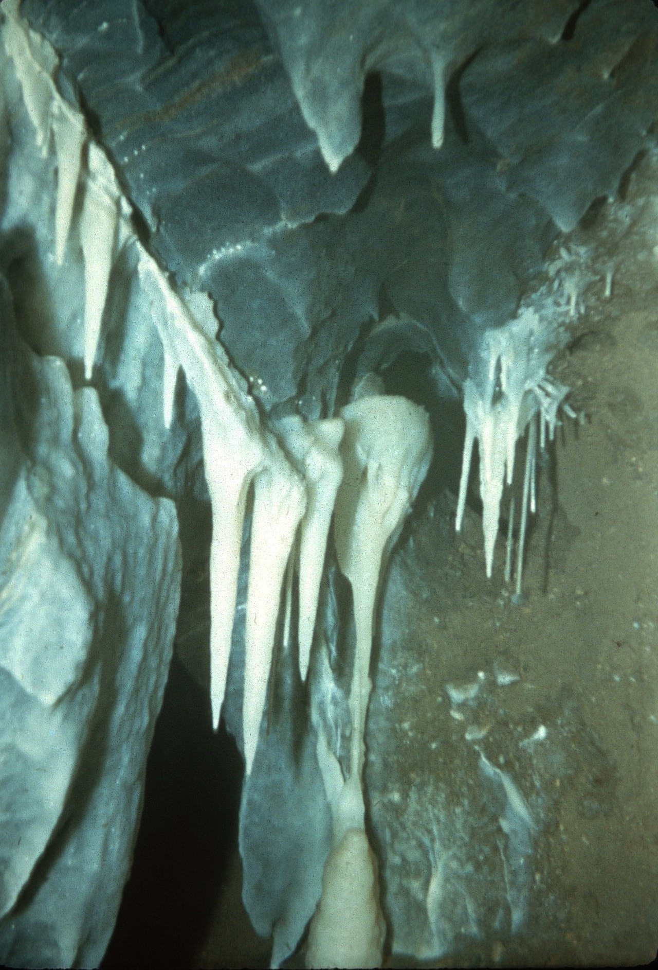
Notes:
The outer parts of CONICAL STALACTITES are not formed by dripping water, but by flowing water. Usually, during the later history of a stalactite, water begins to flow down the outside of the tube, and deposition takes place on the surface, enlarging the tubular stalactite into a conical shape.

Slide 20
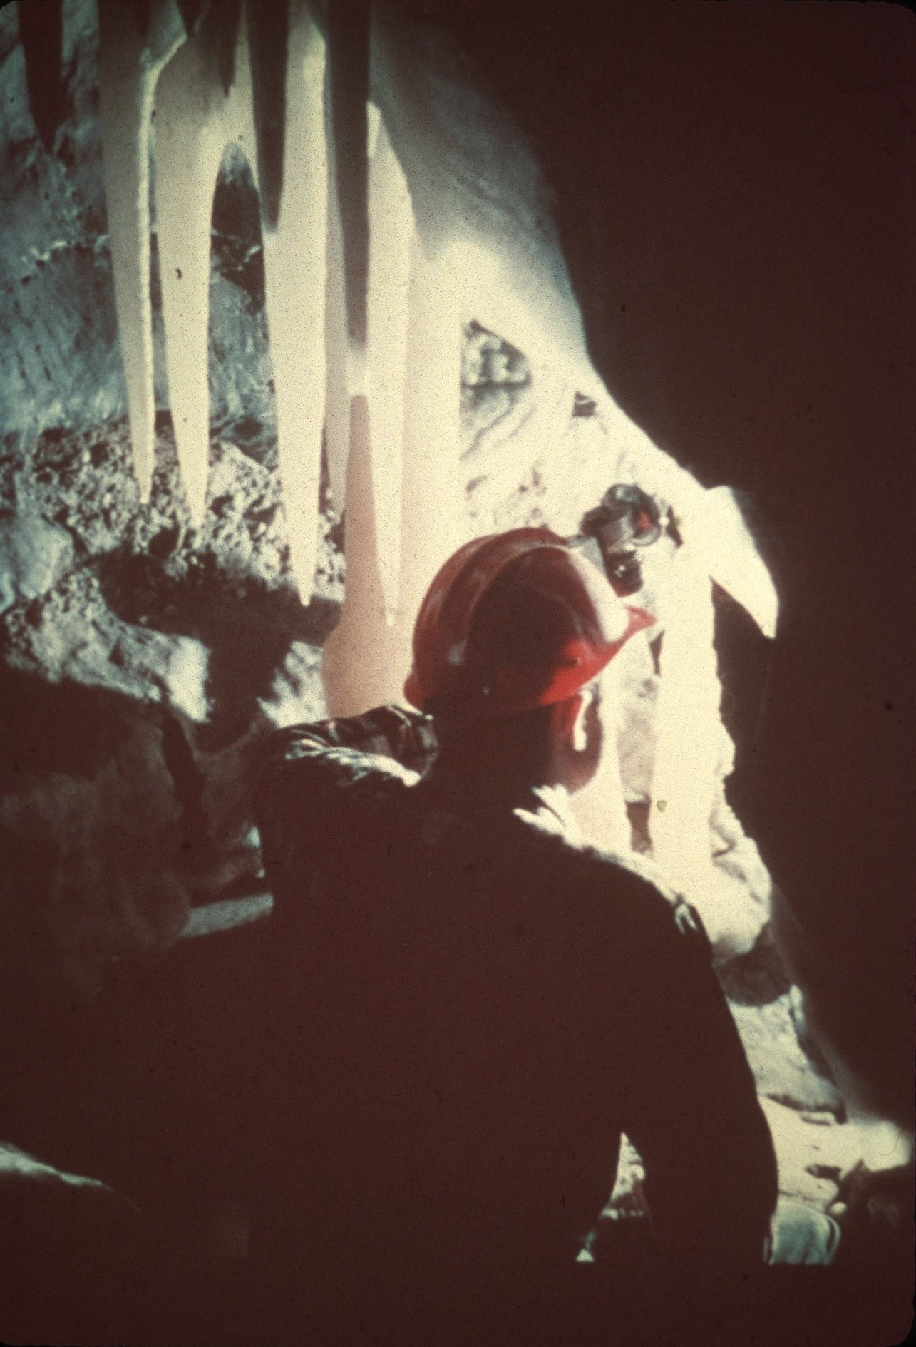
Notes:
The deposits on the outside of stalactites are in the layers parallel with the surface. In cross-section, these layers appear as rings made visible by different amounts of impurities in the different layers. These rings do not necessarily represent annual accumulations, and thus far, attempts to use them for dating cave deposits have been mostly discouraging.

Slide 21
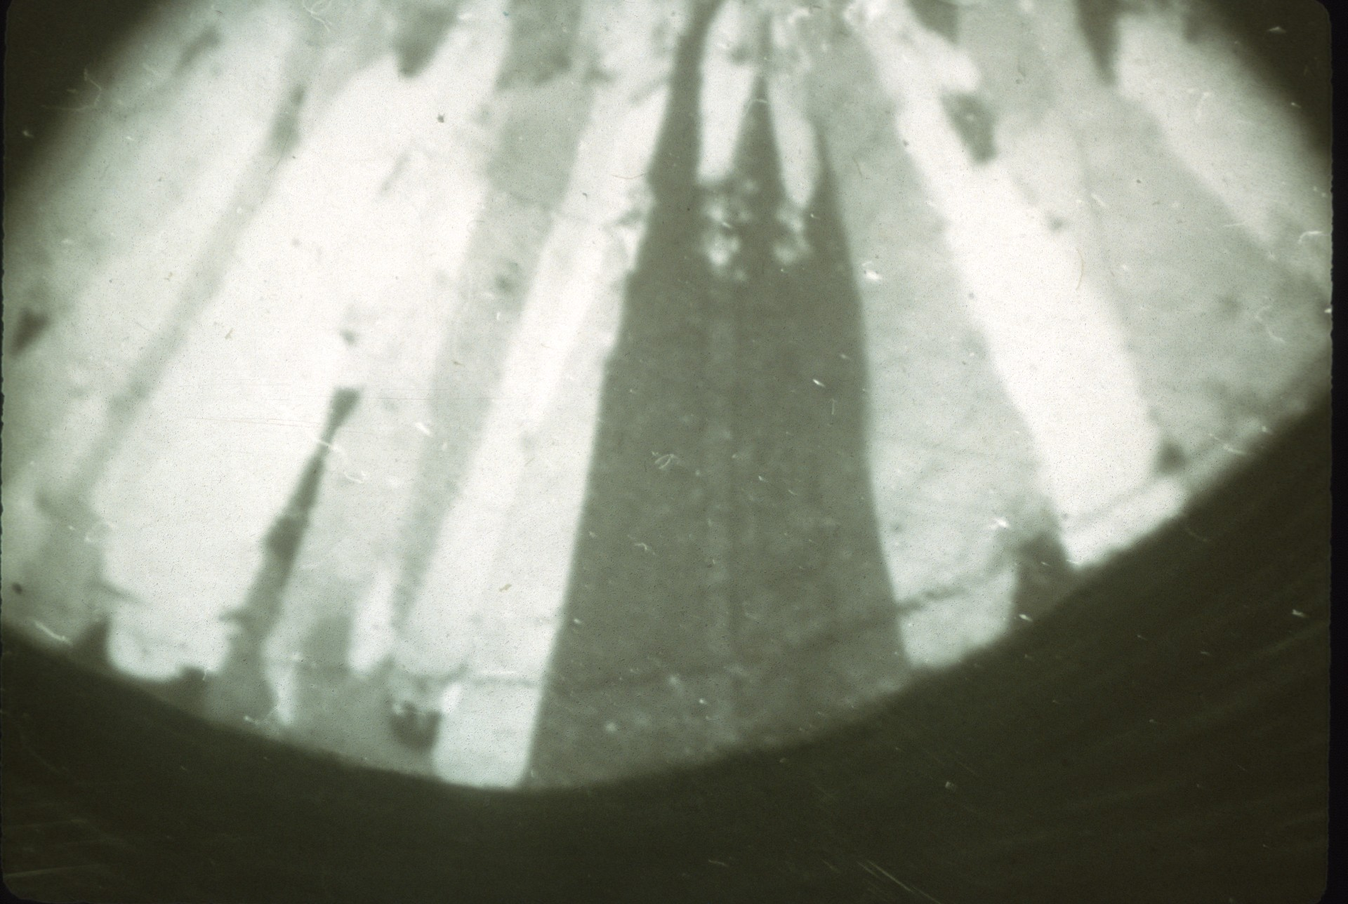
Notes:
The deposits on the outside of stalactites do not follow the crystal lattice of the tubular stalactite. Instead, these crystals grow outward everywhere from the surface of the tube, as shown by this partial cross-section of a stalactite, taken with polarized light to make the individual crystals stand out. There is a radial structure made of small wedge-shaped crystals with their apexes adjacent to the tubular stalactite. As conical stalactites become large, the bases of these crystals on the outer surfaces of the stalactite may be as large as an inch in diameter.

Slide 22
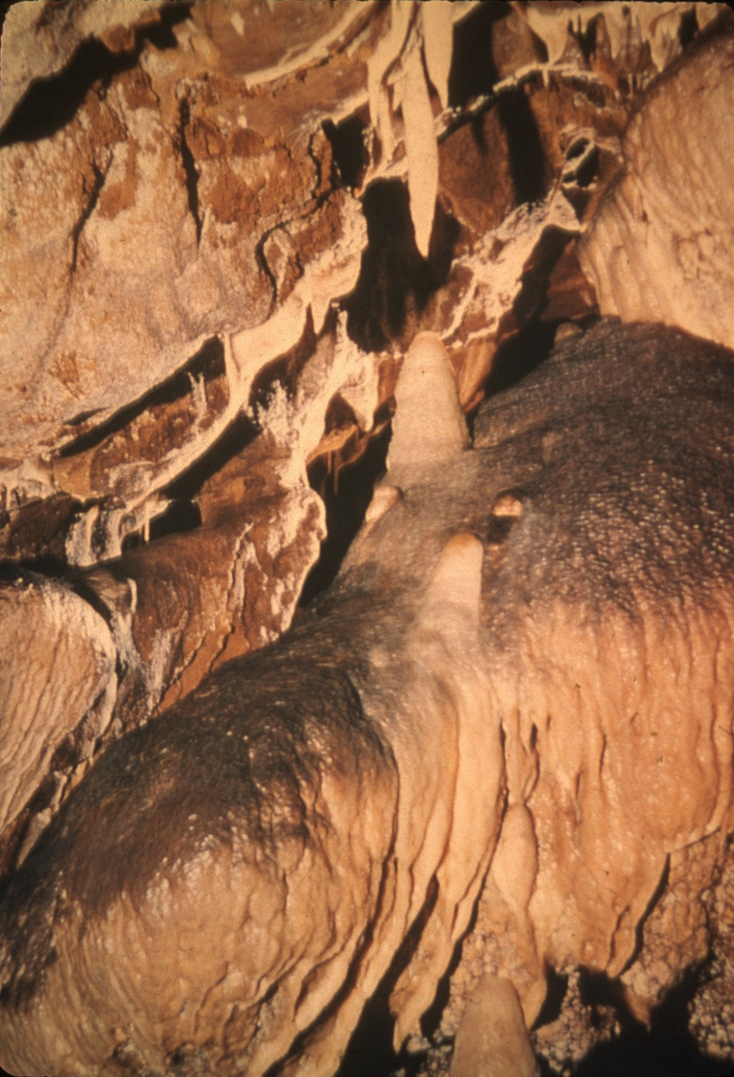
Notes:
STALAGMITES are counterparts of stalactites and rise from the floors of caves. Though their positions are determined by falling water, the shape of stalagmites is not controlled to any great extent by hanging drops of water. Their form and crystal structure are determined more nearly by the same processes that control the shapes of other deposits laid down by flowing water.

Slide 23
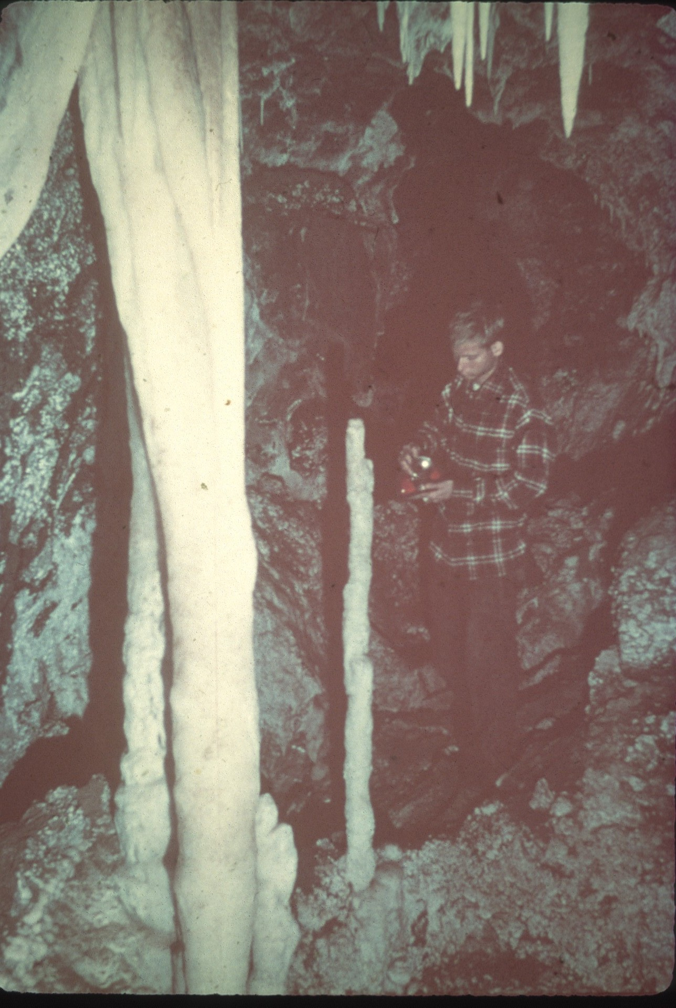
Notes:
As drops fall from stalactites, they retain some excess carbon dioxide. The shock of the drops striking the top of a stalagmite causes the gas to be driven off, just as carbon dioxide is released when a bottle of soda water is shaken. In this way, calcite is laid down and stalagmites grow upward, layer by layer, to meet their stalactites.

Slide 24
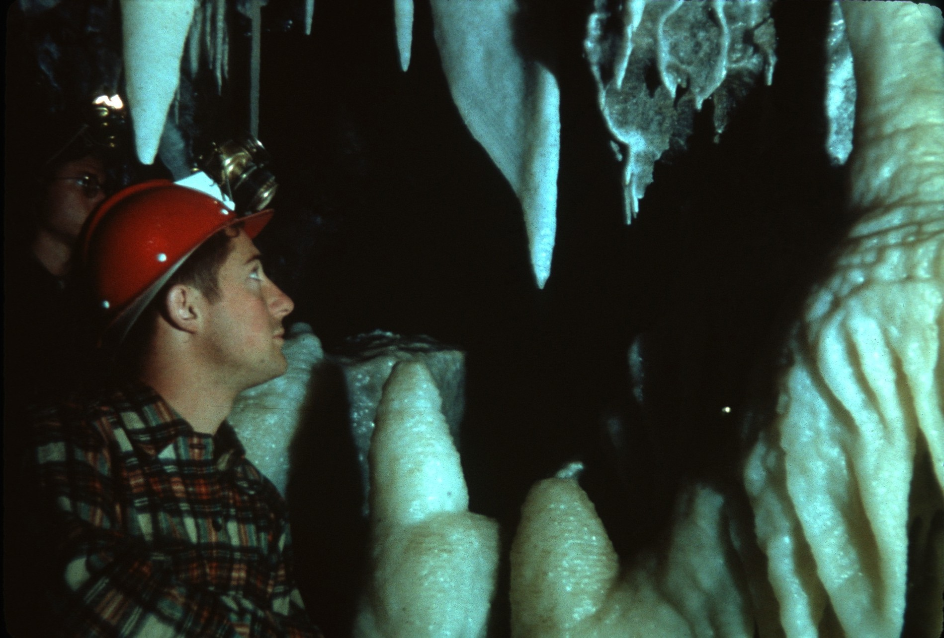
Notes:
Stalagmites are usually larger in diameter than the stalactites which form them, and generally have rounded tops instead of pointed tips like stalactites. Stalagmites have no central tube. Sometimes they grow to be over fifty feet tall and twenty or thirty feet in diameter.

Slide 25
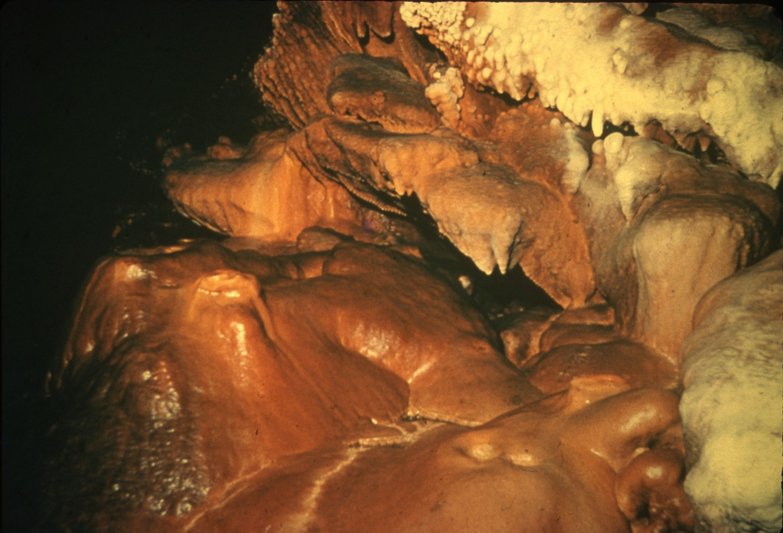
Notes:
Some stalagmites have cup-shaped splash basins on their apexes. These small “craters” are usually about two inches in diameter and have rims about half an inch high. There is evidence that most of these splash basins are formed when the water becomes more acidic and begins to dissolve away part of the stalagmite. It is possible, however, that some splash basins are primary deposits, formed without the aid of solution.

Slide 26
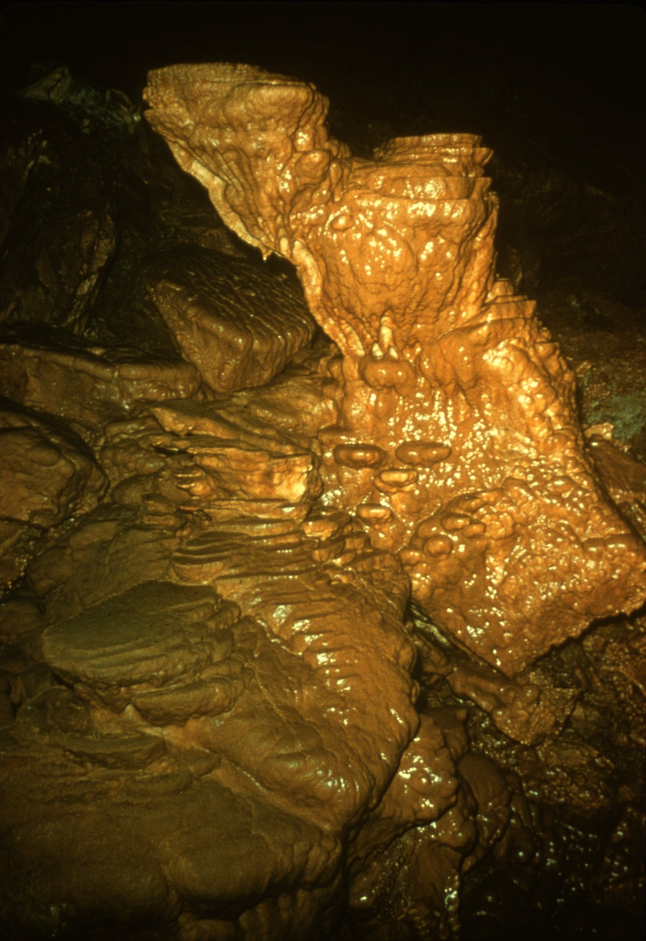
Notes:
When drops fall from great height, they commonly form flat-topped stalagmites. These stalagmites are usually made up of a series of slightly offset plates about half an inch thick, averaging about eight inches in diameter.

Slide 27
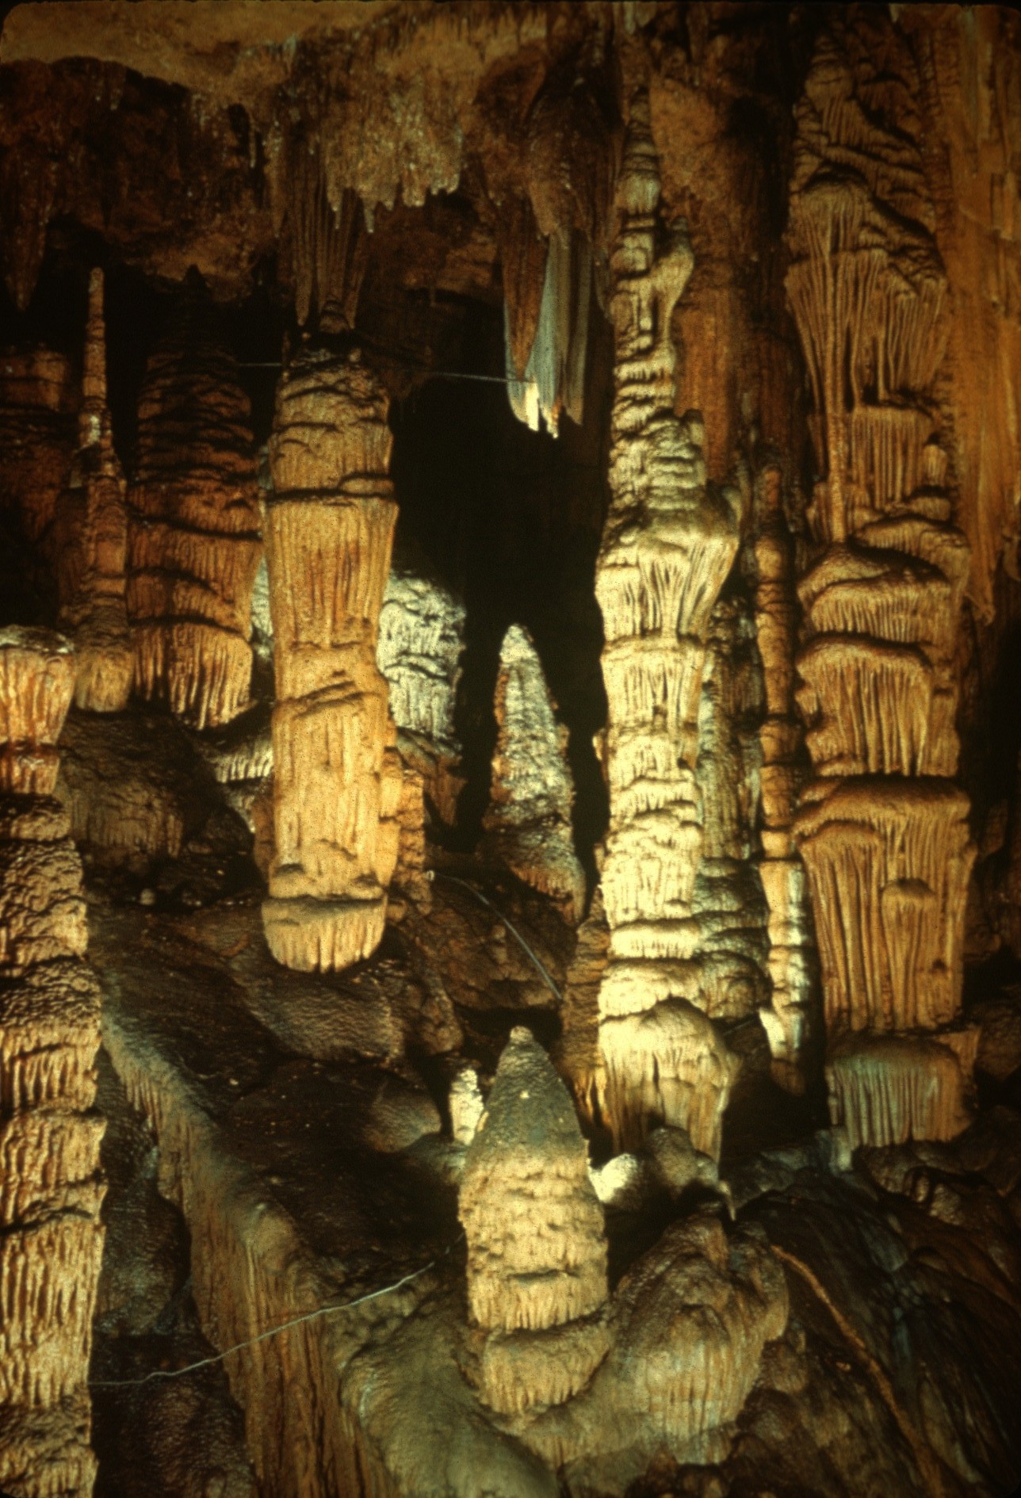
Notes:
Some stalagmites have leaf-like appendages extending outward and upward from their trunks. These stalagmites are also formed by water dripping from great heights, and the appendages grow only where falling drops reach them. Each leaf is sheltered by the leaves above, and deposition can occur only at the outer edges, causing the leaves to grow outward and upward.

Slide 28
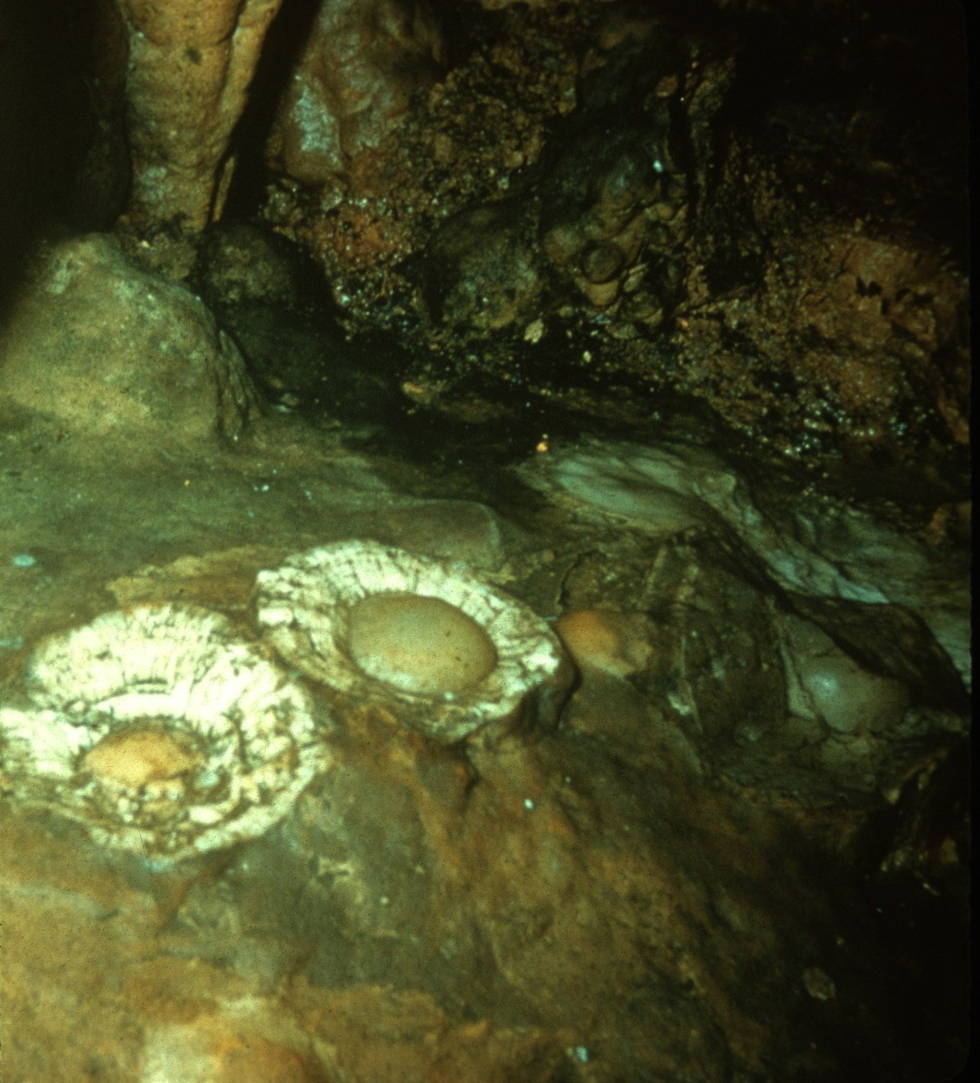
Notes:
Stalagmites have a crystal structure similar to that of the outer part of stalactites. Occasionally, if the dripping solutions have few impurities, a stalagmite forms as a single crystal, but ordinarily the structure is radial, with many crystals perpendicular to the surface of growth. Wedge- and pyramid-shaped crystals extend outward from the interior.

Slide 29
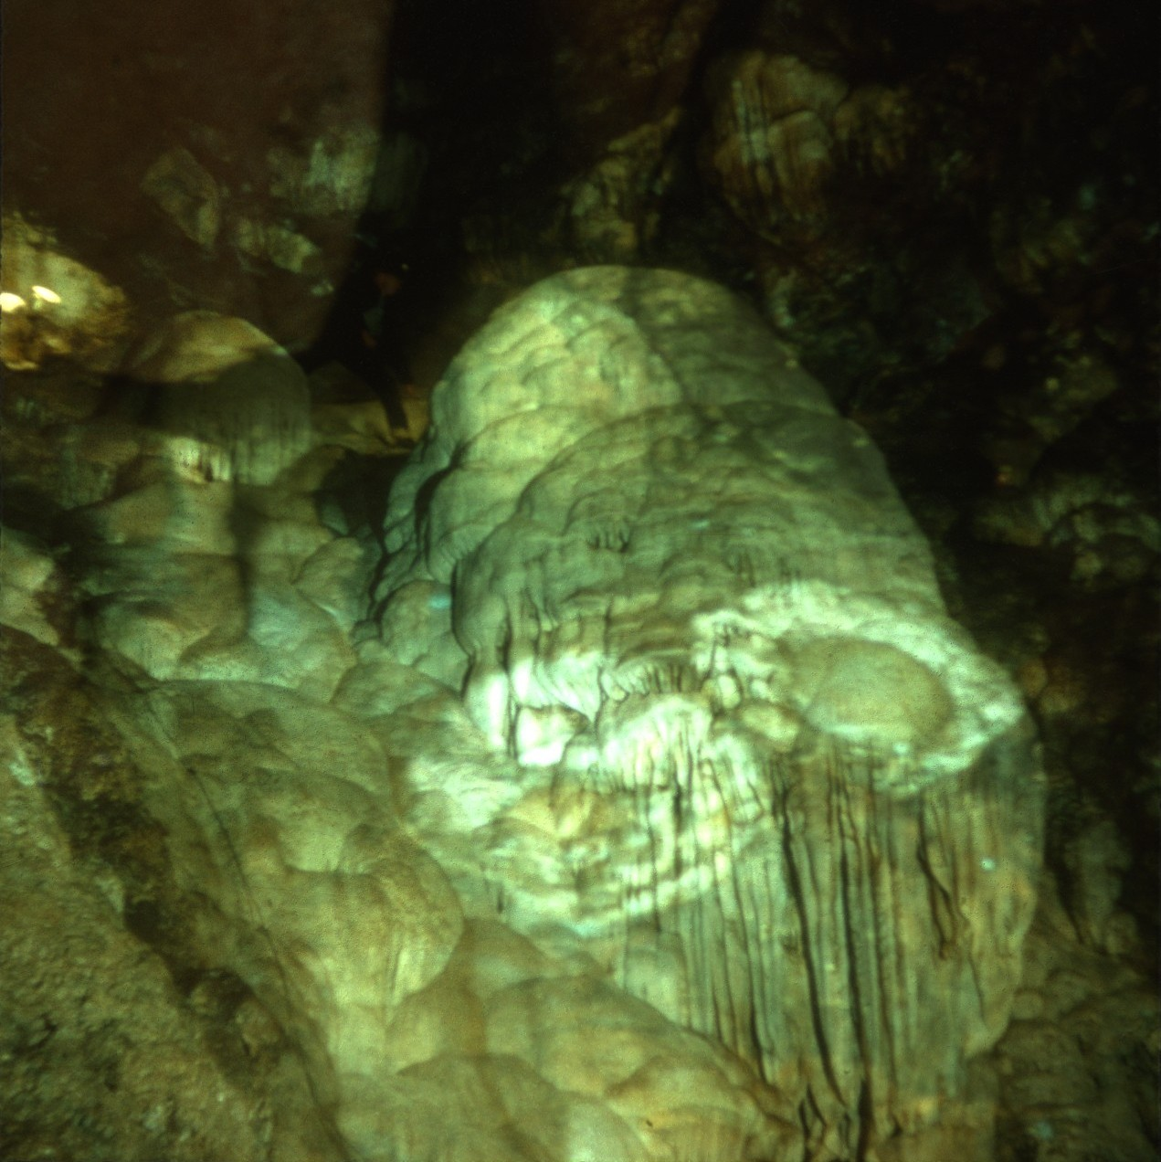
Notes:
Some measurements have been made of the rate of growth of stalagmites, and the rate appears to be about the same as that of stalactites. Stalagmites grow at a maximum rate of little more than a tenth of an inch a year and probably average about a hundredth of an inch a year.

Slide 30
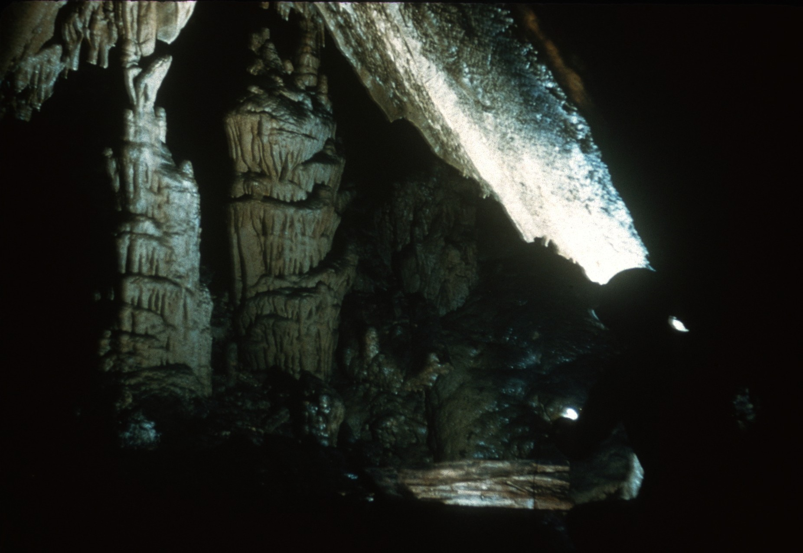
Notes:
When a stalactite and stalagmite grow together, a COLUMN is formed. After the two have met, water flowing from above seals over the juncture until no evidence remains on the surface of the stalagmite or stalactite.

Slide 31
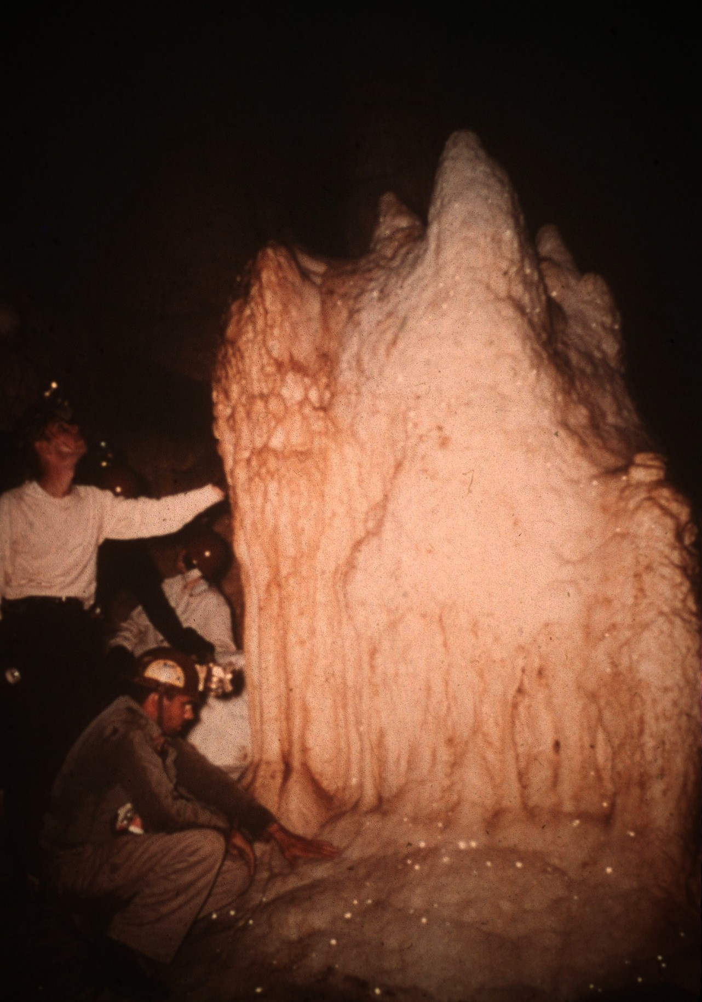
Notes:
When water flows down the walls of a cave, sheets of travertine called FLOWSTONE are laid down. Deposits of flowstone may be very massive. The crystals in the flowstone are oriented perpendicular to the surface of deposition and sometimes individual crystals grow very large on the outer surface of a deposit. The surface is smooth, however, and the presence of the crystals can be detected only by the way in which they sparkle.

Slide 32
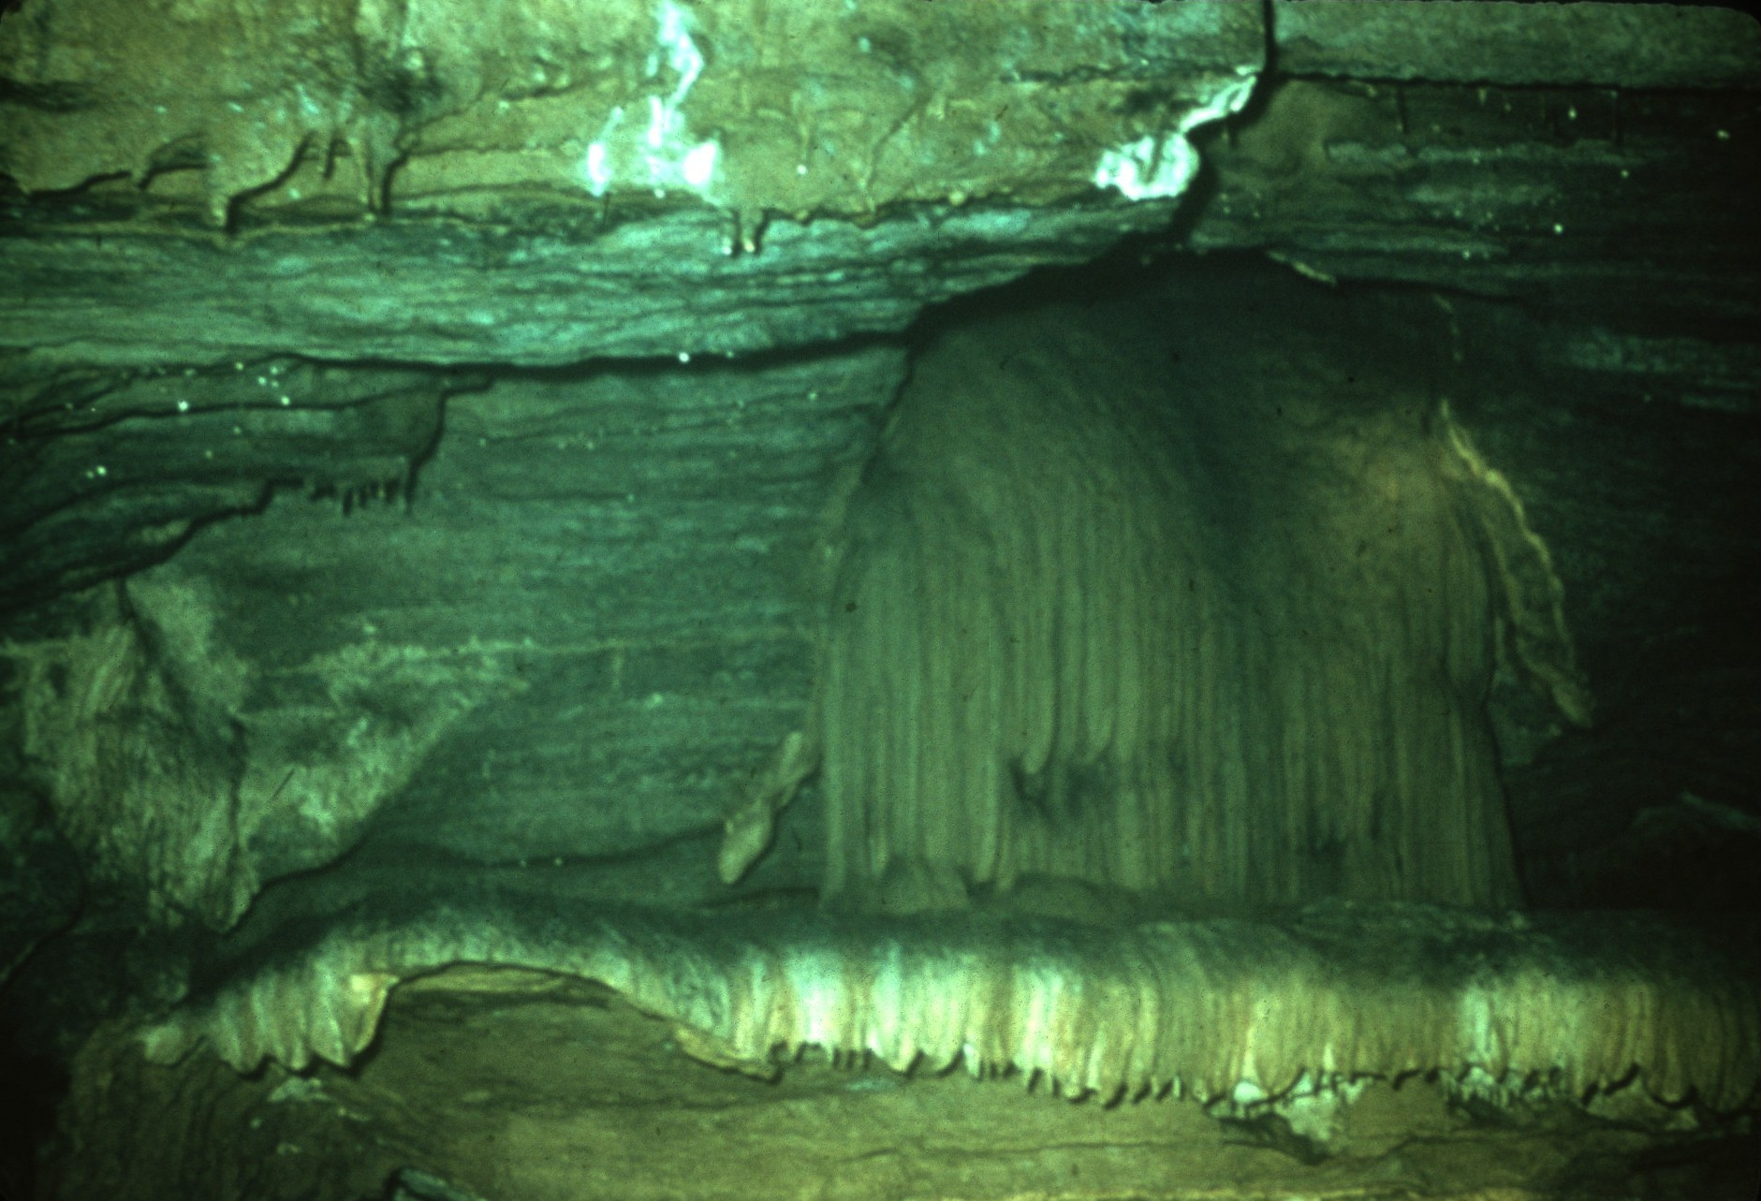
Notes:
In some caves, flowstone forms over gravel or silt beds. In places, the gravel or silt is later washed out from under the flowstone, producing unsupported hanging deposits that are called CANOPIES.

Slide 33
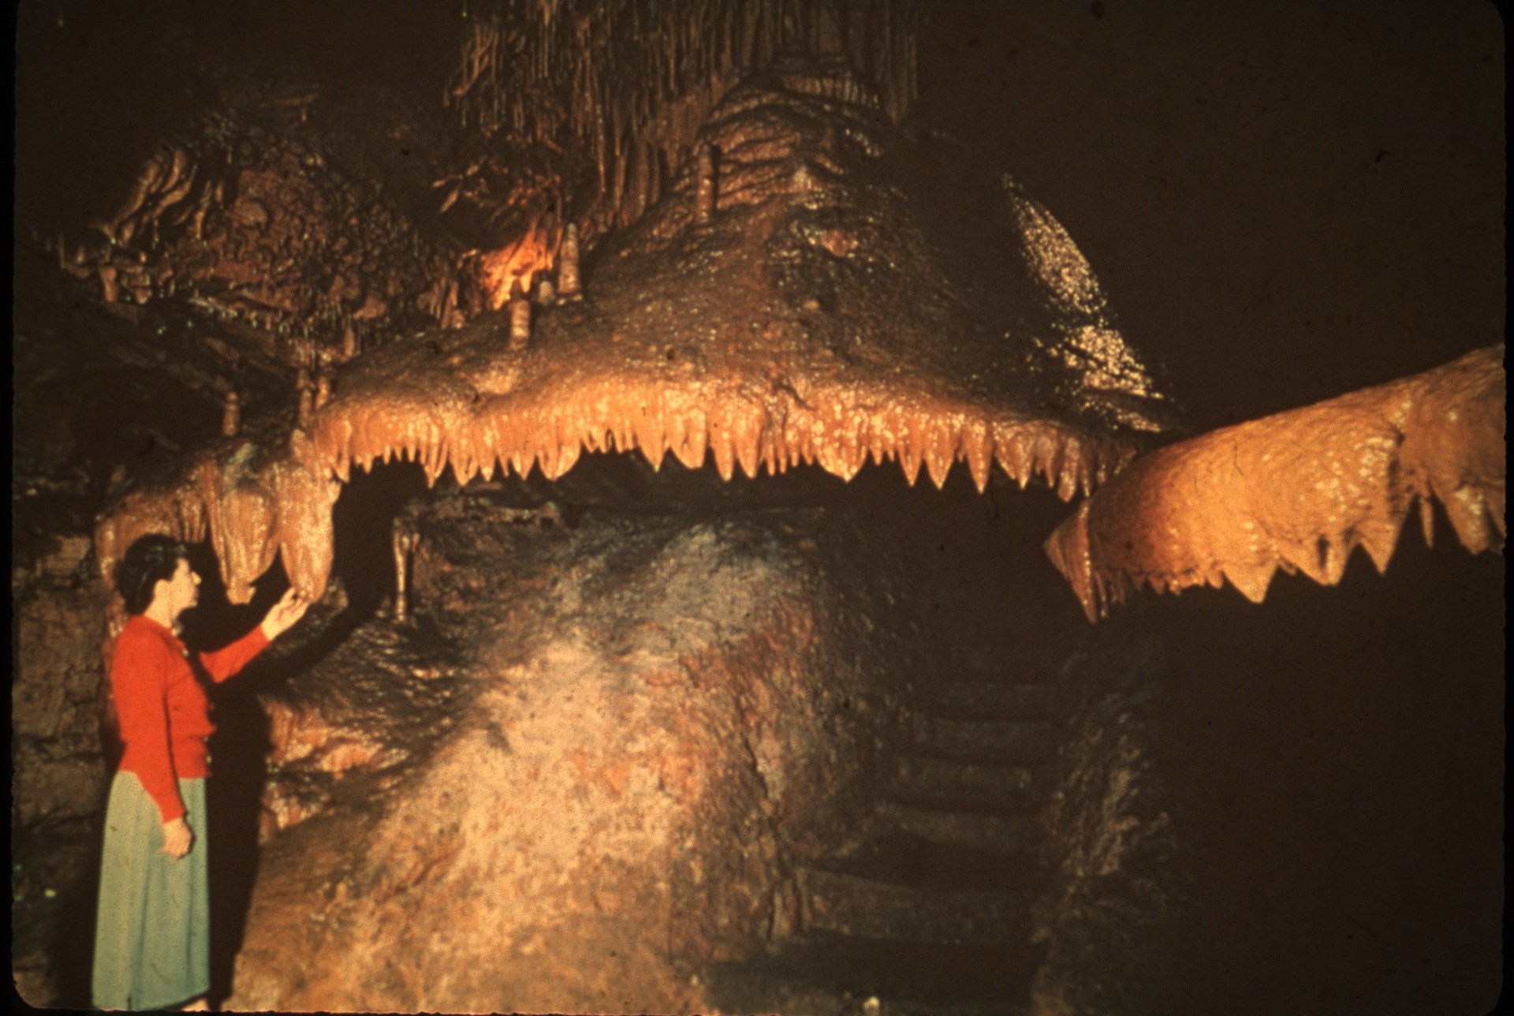
Notes:
These speleothems often have impressions of mud cracks on their surfaces. Beautiful hanging deposits are formed when water continues to run over the flowstone and stalactites are deposited from the lip of the canopy.

Slide 34
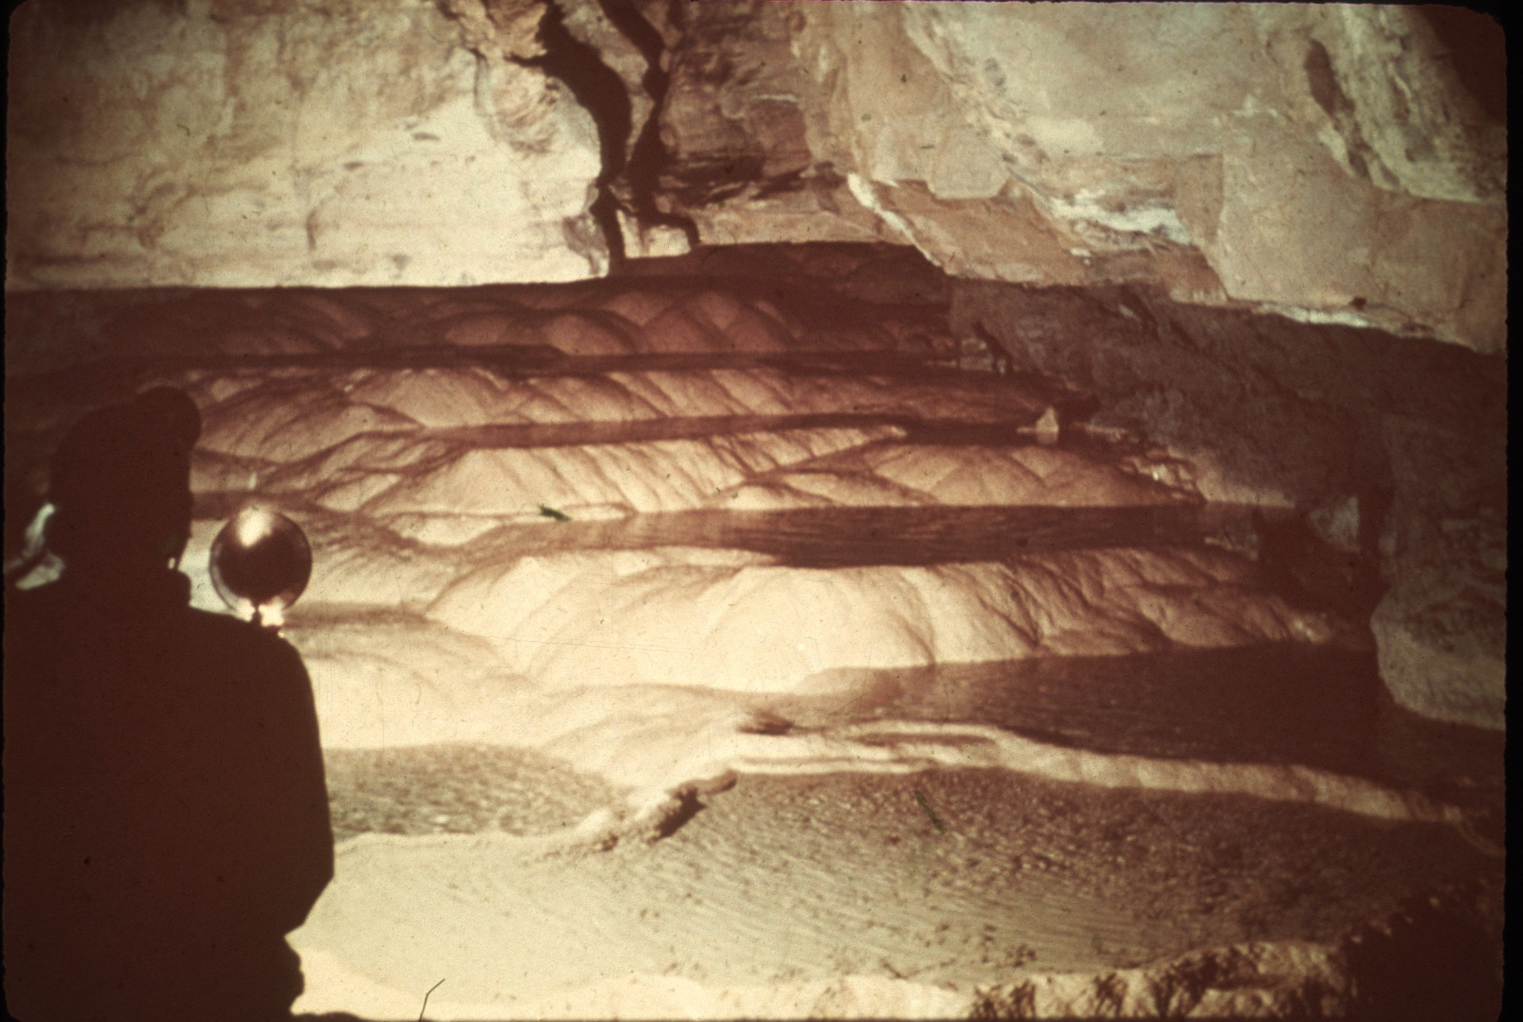
Notes:
Curious, though fairly common, deposits in caves are RIMSTONE DAMS. Rimstone dams are elongated bodies on the floors of caves that impound small pools of water, or in some cases, dam cave streams. They usually occur in a series, in steps, so that crescent-shaped pools are formed and the water flows over the dams from one pool to another.

Slide 35
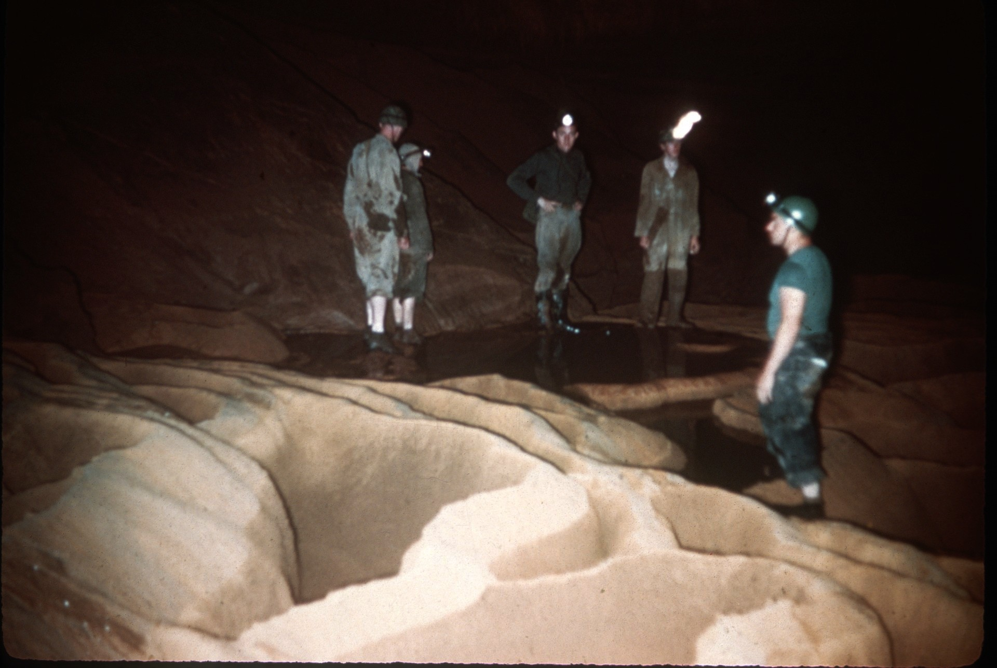
Notes:
Rimstone dams range greatly in size; sometimes they are only a fraction of an inch high, while in other caves, they form pools four to five feet deep. One idea of the origin of rimstone dams is that as the water flows over the lip of the dam, it is slightly agitated, causing carbon dioxide to be given off. This results in deposition of calcium carbonate on the lip of the dam.

Slide 36
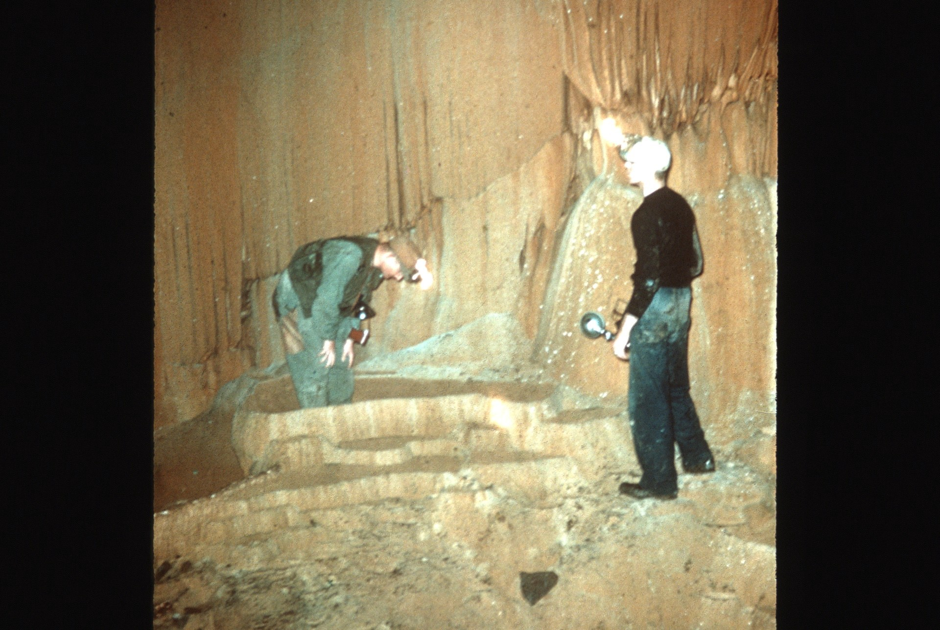
Notes:
More water flows over low areas of the dam, do deposition is greater there and a level top is maintained on the dam. It is also possible that microorganisms may play a apart in the formation of rimstone dams. Bacteria or algae living on soluble components in the water could cause a precipitation of calcite on the dams.

Slide 37
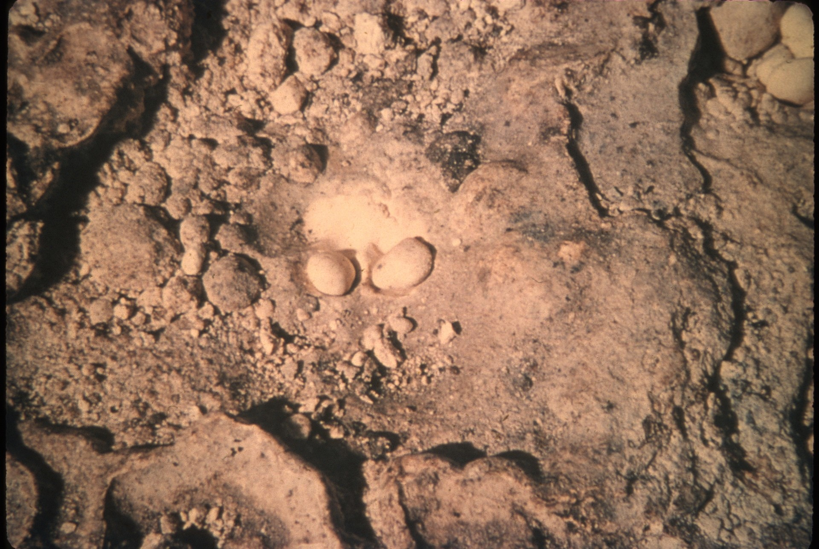
Notes:
One of the most interesting types of speleothems is the CAVE PEARL. Casteret [Ka-sta-ray] has called cave pearls the rarest of all cave deposits. One of the reasons these small spherical deposits are uncommon is that they are loose and can be carried from the caves by visitors.

Slide 38
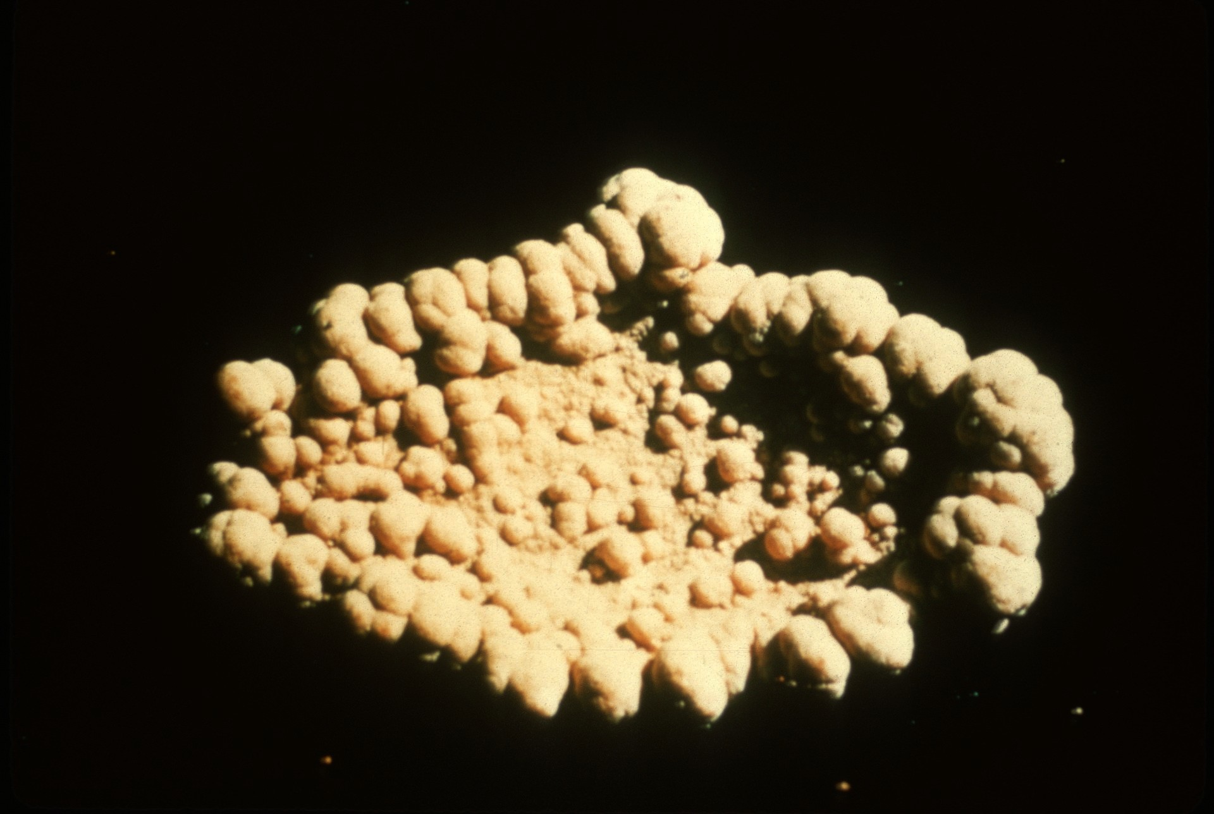
Notes:
Cave pearls range in size from small structures the size of the head of a pin to irregular bodies as much as six inches in diameter. Generally, the smaller deposits are nearly spherical, while larger ones tend to be irregular. Cave pearls less than two millimeters in diameter are called oolites (after the eggs of fish), while those of larger diameter are called pisolites (after peas).

Slide 39
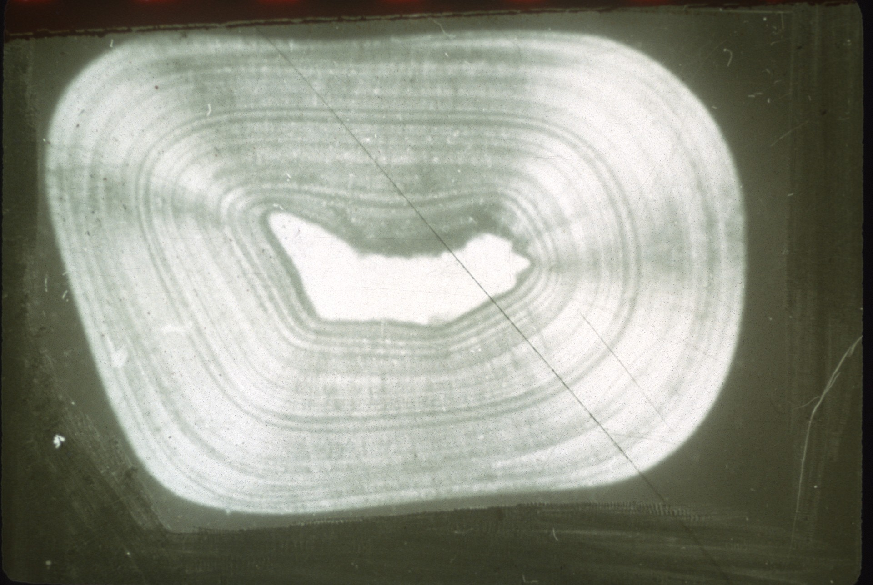
Notes:
Cave pearls generally have a nucleus which may be a small grain of sand or a fragment of another speleothem. Outward from this nucleus, concentric layers of calcite or aragonite are laid down in much the same fashion as the layers are deposited on an oyster pearl. As in other deposits formed by flowing water, and in common with oyster pearls, the crystals are perpendicular to the surface of growth, in a radial pattern.

Slide 40
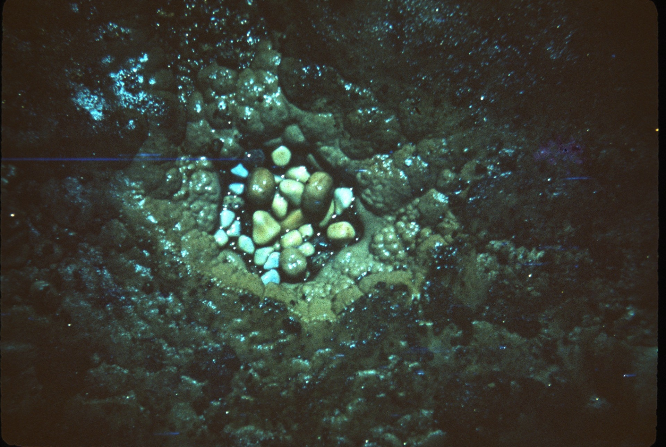
Notes:
Many cave pearls are formed in small nests below dripping water. Constant agitation by dripping water and rotation seems to be necessary for the formation of large spherical pearls. Rotation is not essential, however, in keeping the pearl from attaching itself to the floor, for often large number of pearls that are nearly cubes nestle together. Though they cannot move much with respect to each other, they maintain their individuality and seem to grow equally on all sides.

Slide 41
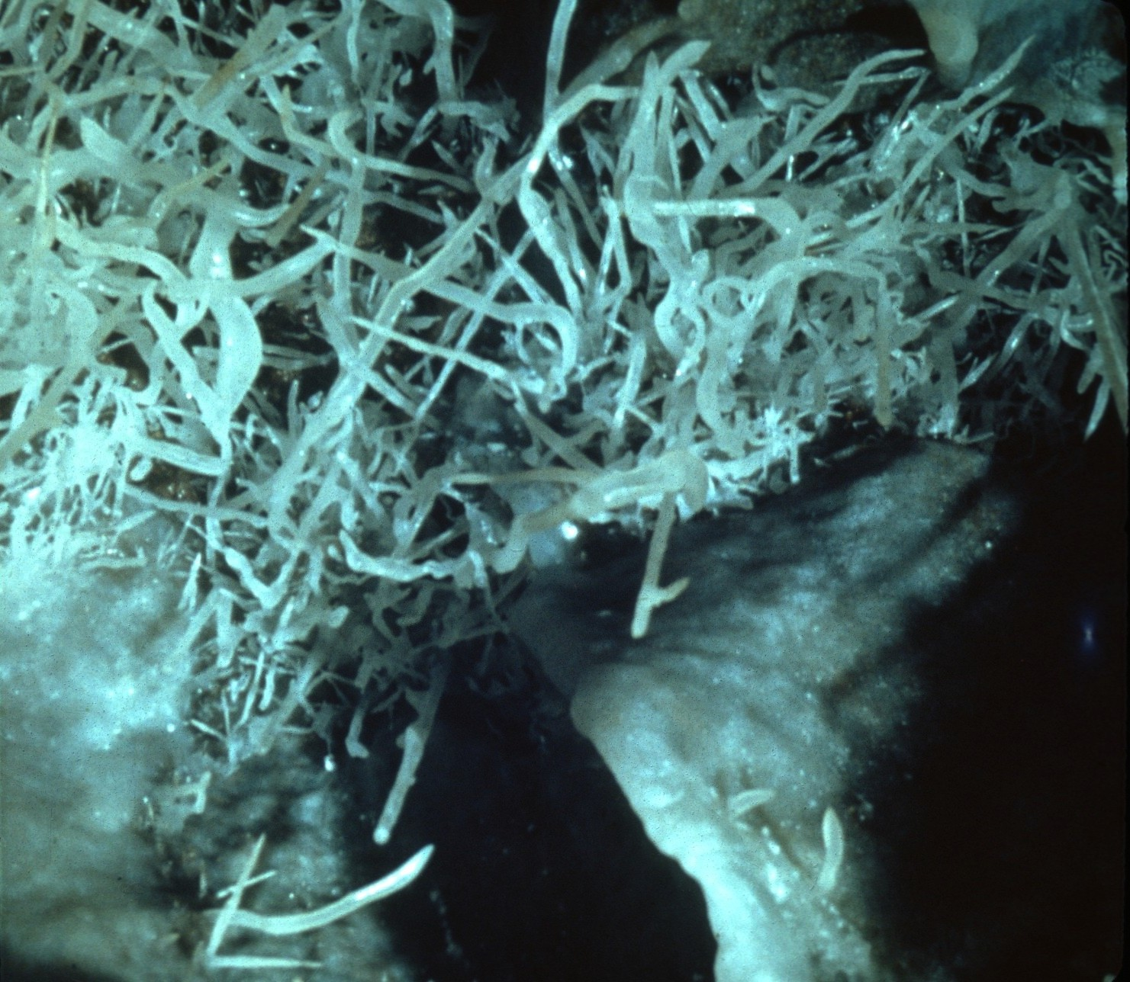
Notes:
Perhaps the most interesting cave deposits are formed by seeping water. These speleothems have curious shapes, seem to defy gravity, and include some of the most delicate and beautiful types.

Slide 42
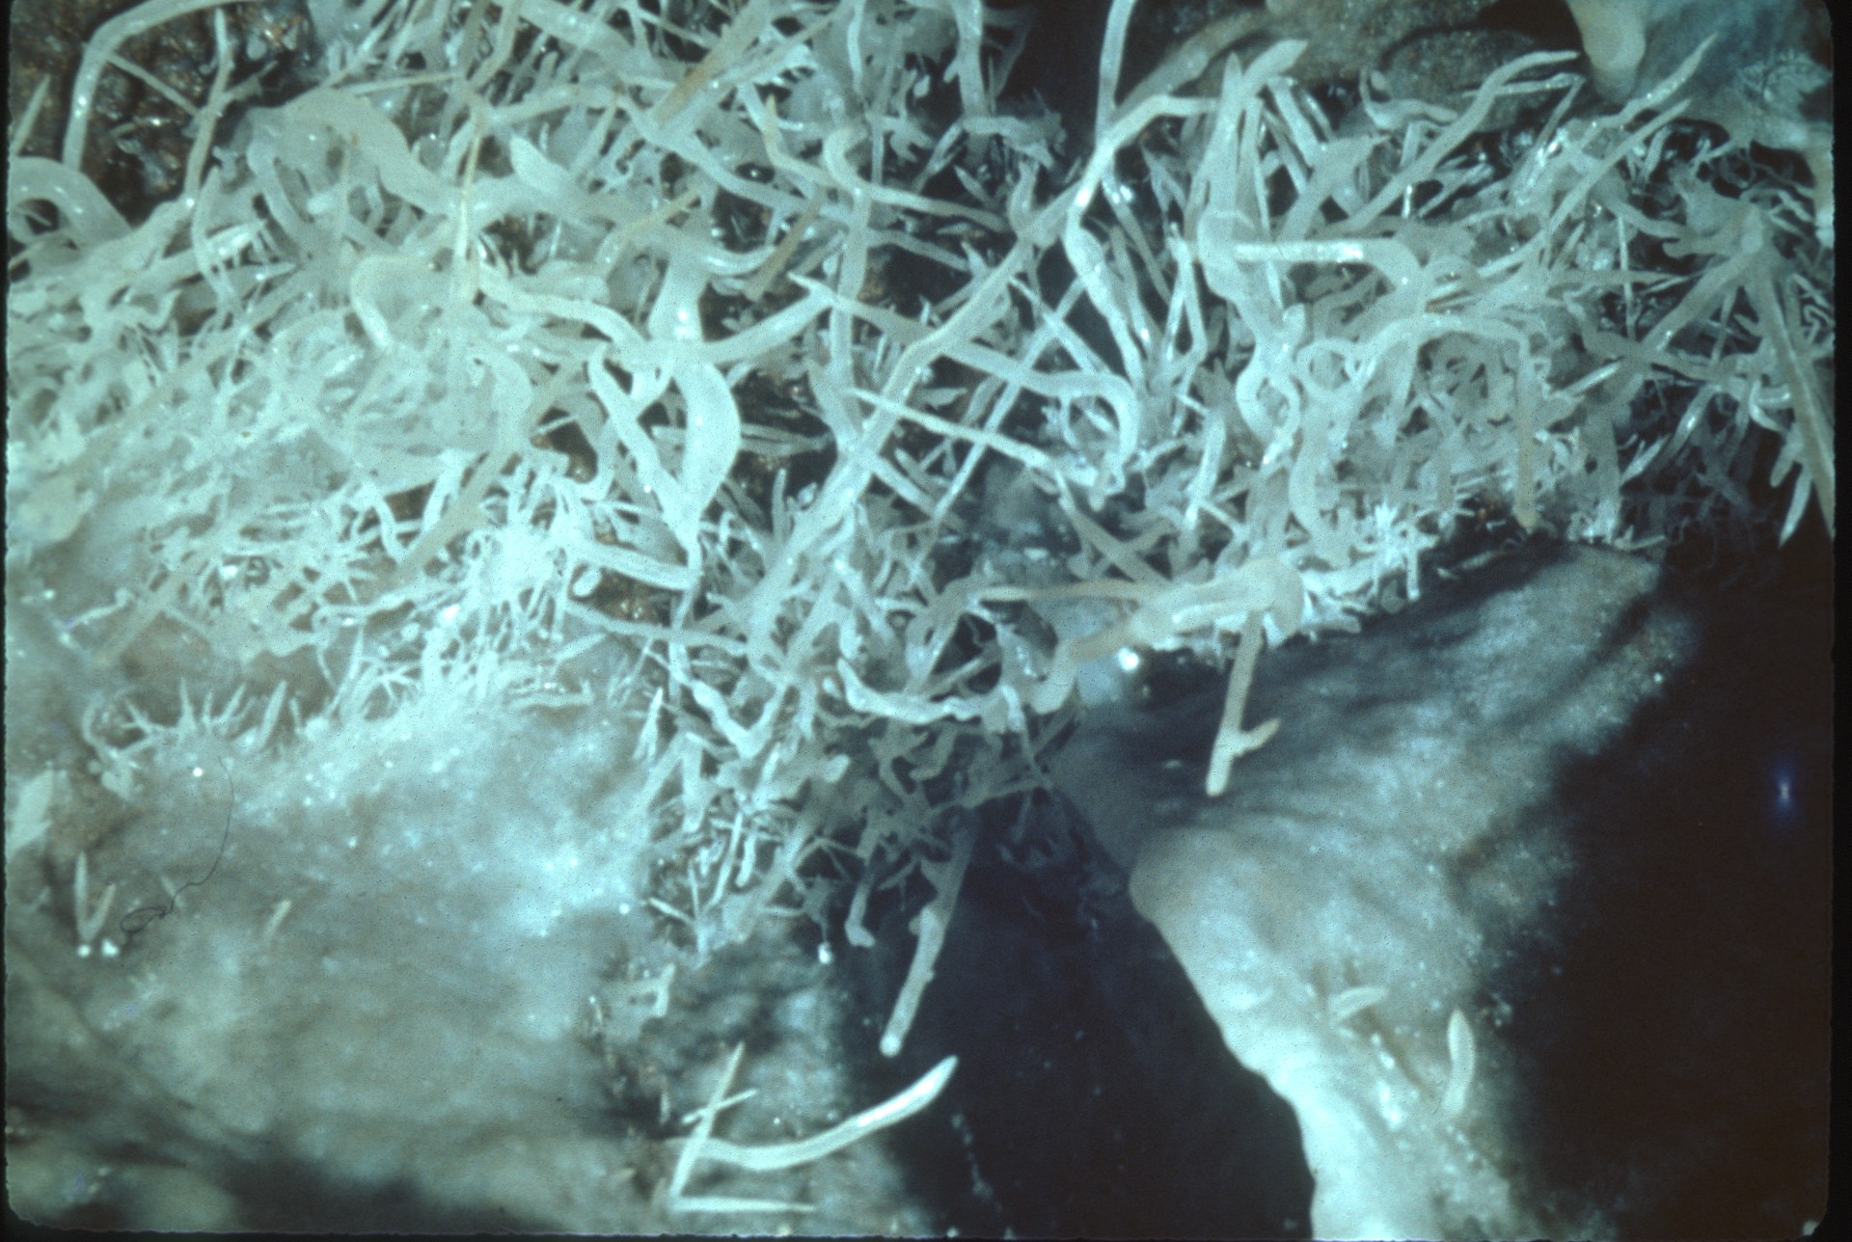
Notes:
HELICTITES are some of the best known and most puzzling cave deposits formed by seeping water. They are small, twisted structures, usually several inches long and about a quarter of an inch in diameter. Some have called them “eccentric stalactites” for they project from the ceilings, walls, and floors of caves at many angles.

Slide 43
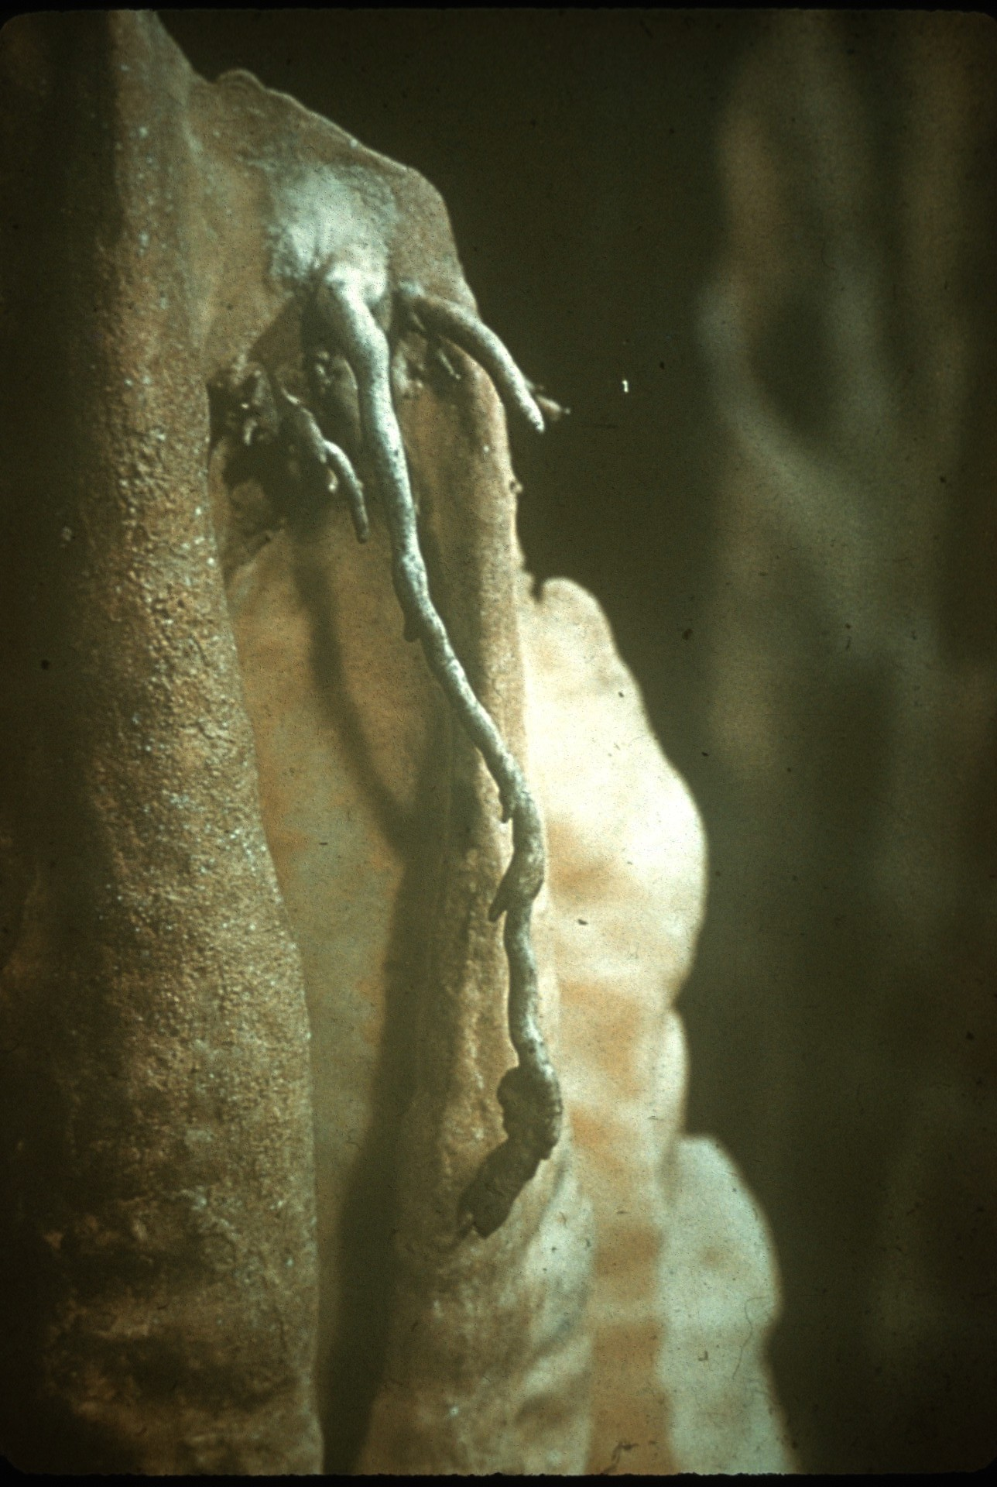
Notes:
Helictites have excited the imaginations of speleologists for many years and perhaps more hypotheses of origin have been proposed for this speleothem than for any other. Some of the most interesting ideas that have been presented are that these strange deposits result from deposition on spider webs or fungus, are formed by condensation of vapor containing lime, and curve because of electrical energy.

Slide 44
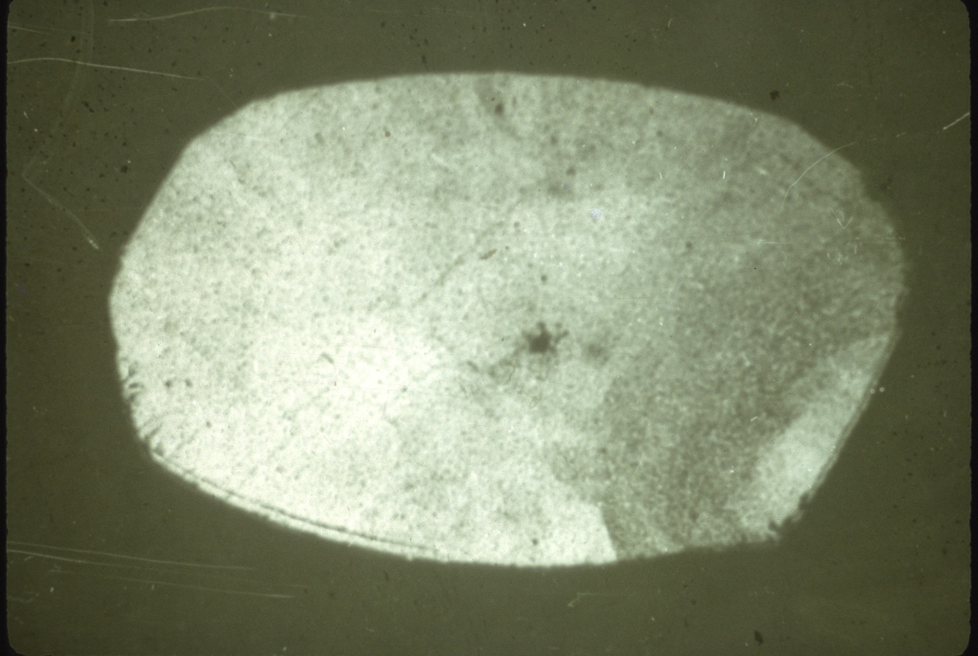
Notes:
The first bit of evidence contributing to a better understanding of the origin of helictites and their curious behavior came when it was observed that they have a narrow central canal extending along their axis. This canal, which is less than a hundredth of an inch in diameter, conducts water from a crack in the wall through the helictite to its tip.

Slide 45
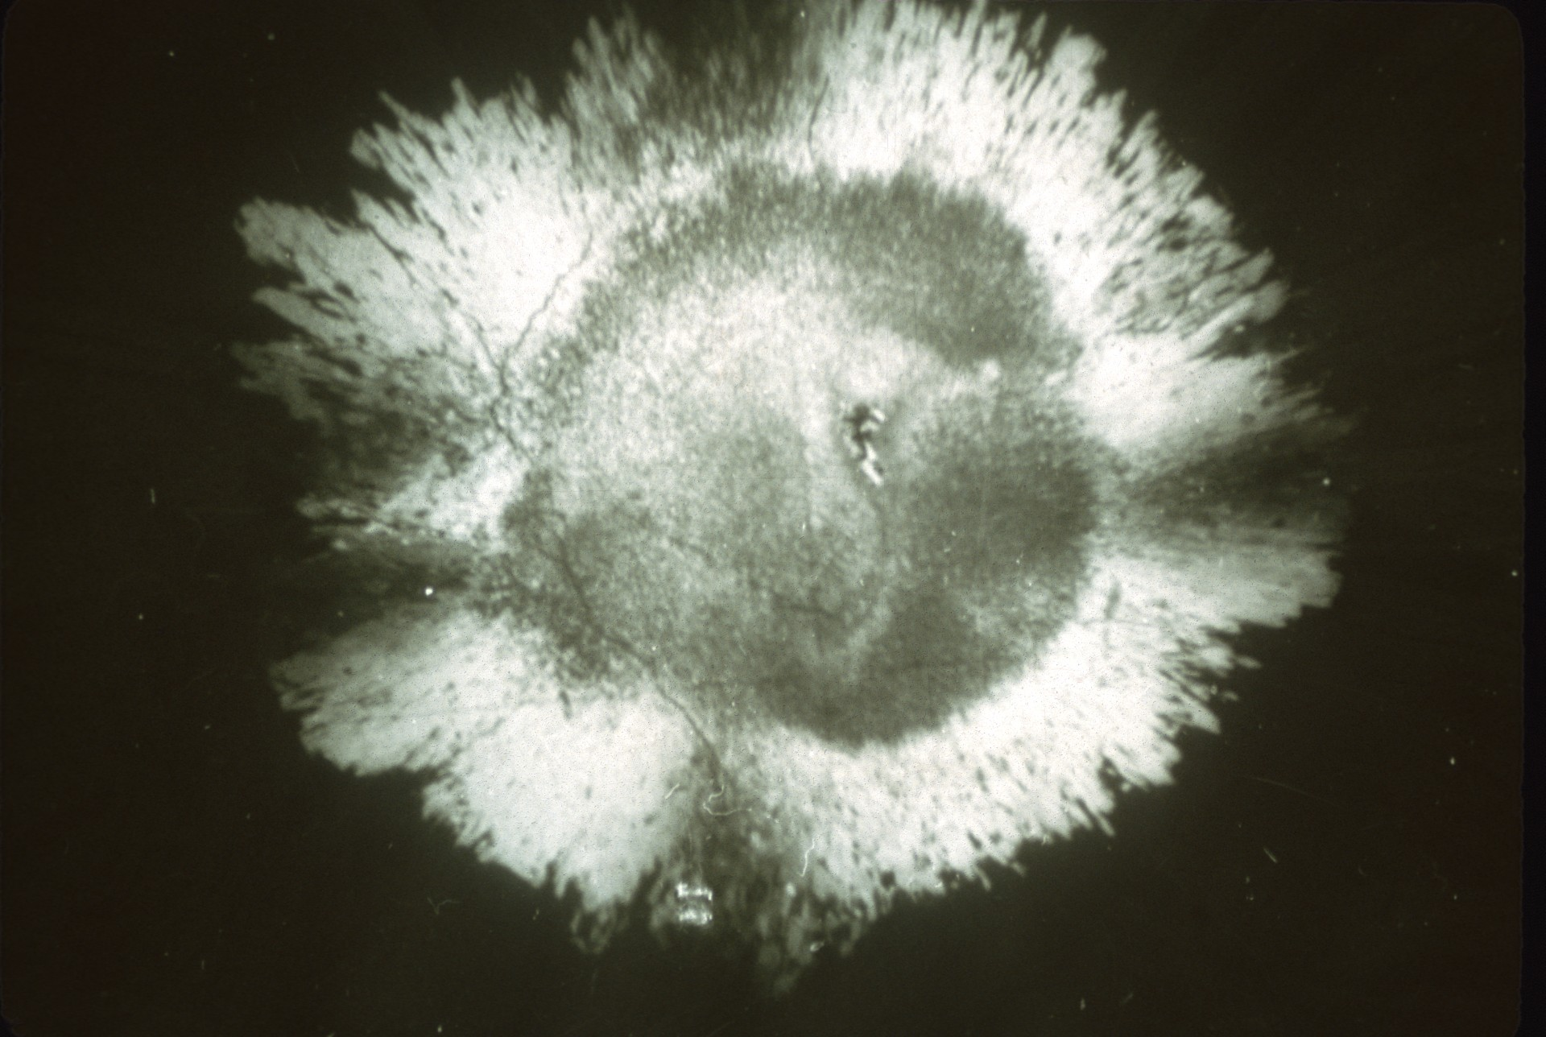
Notes:
In this cross-section of an aragonite helictite, the canal is the small irregular black dot in the center. Deposition of mineral matter takes place on the tip, but the flow is so slow that a drop of water does not form, and gravity is not given an opportunity to affect the shape.

Slide 46
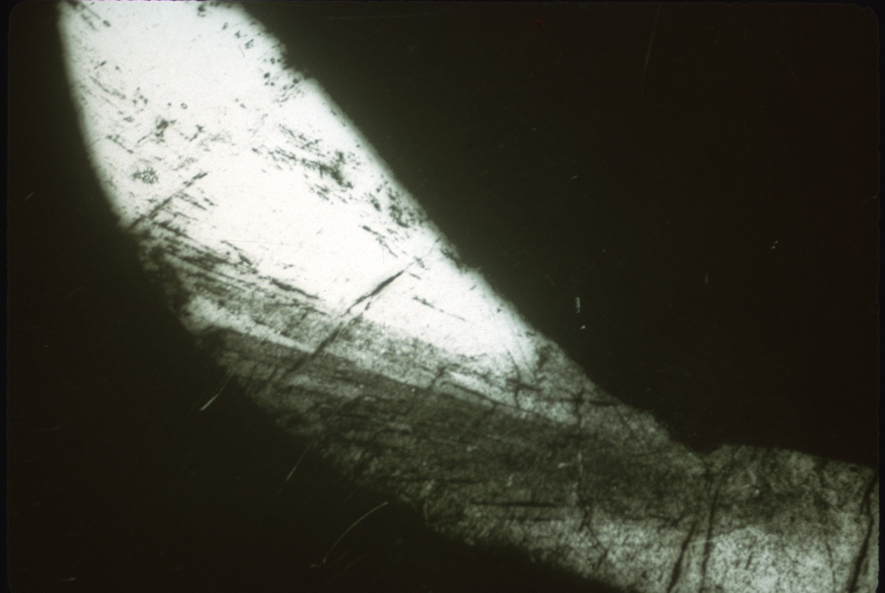
Notes:
For many years after the growth of helictites was understood, the cause of their twisted habit remained a mystery. The most commonly evoked mechanism for their curvature was air currents. It is now known that the internal crystal structure, as shown in this longitudinal section of a calcite helictites, gives them their shape. A helictite is made up of wedge-shaped crystals, and as the wedges are piled together, they are deflected in a smooth curve, resulting in a curved helictite.

Slide 47
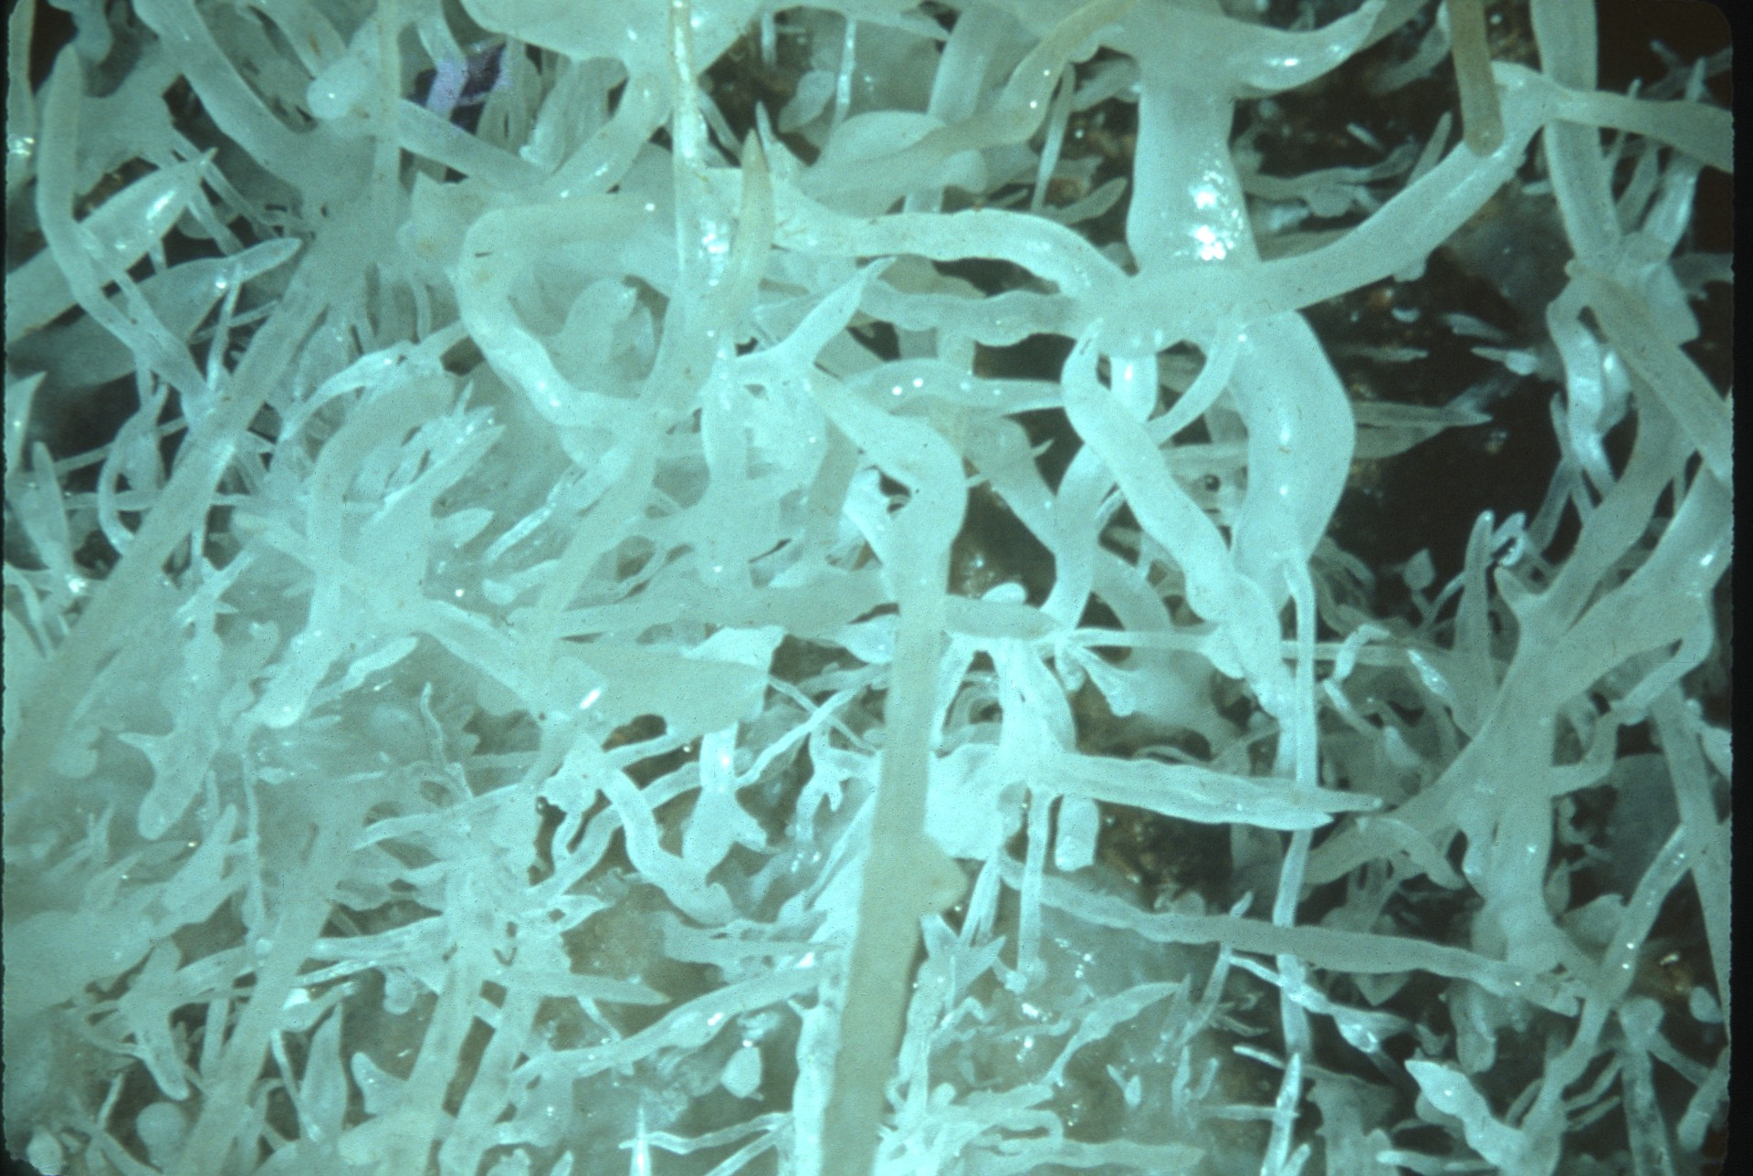
Notes:
Calcite helictites that are free from impurities are often nearly transparent. They have fairly smooth surfaces, and the internal structure is reflected by a triangular cross-section near the tip and a hexagonal cross-section along the body of the helictite.

Slide 48
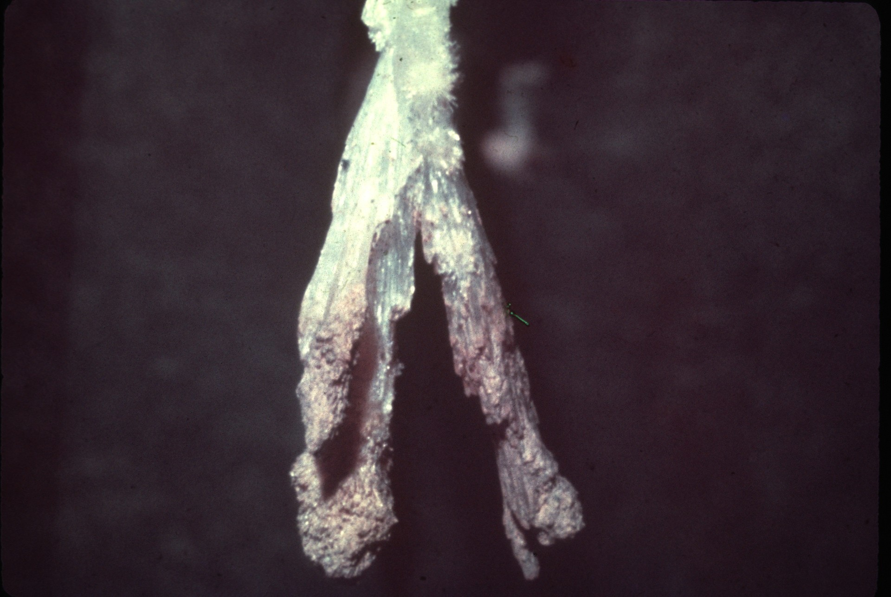
Notes:
The surface of aragonite helictites, however, is rough and made up of many small pointed crystals. These crystals radiate outward from the central canal and are inclined away from the tip.

Slide 49
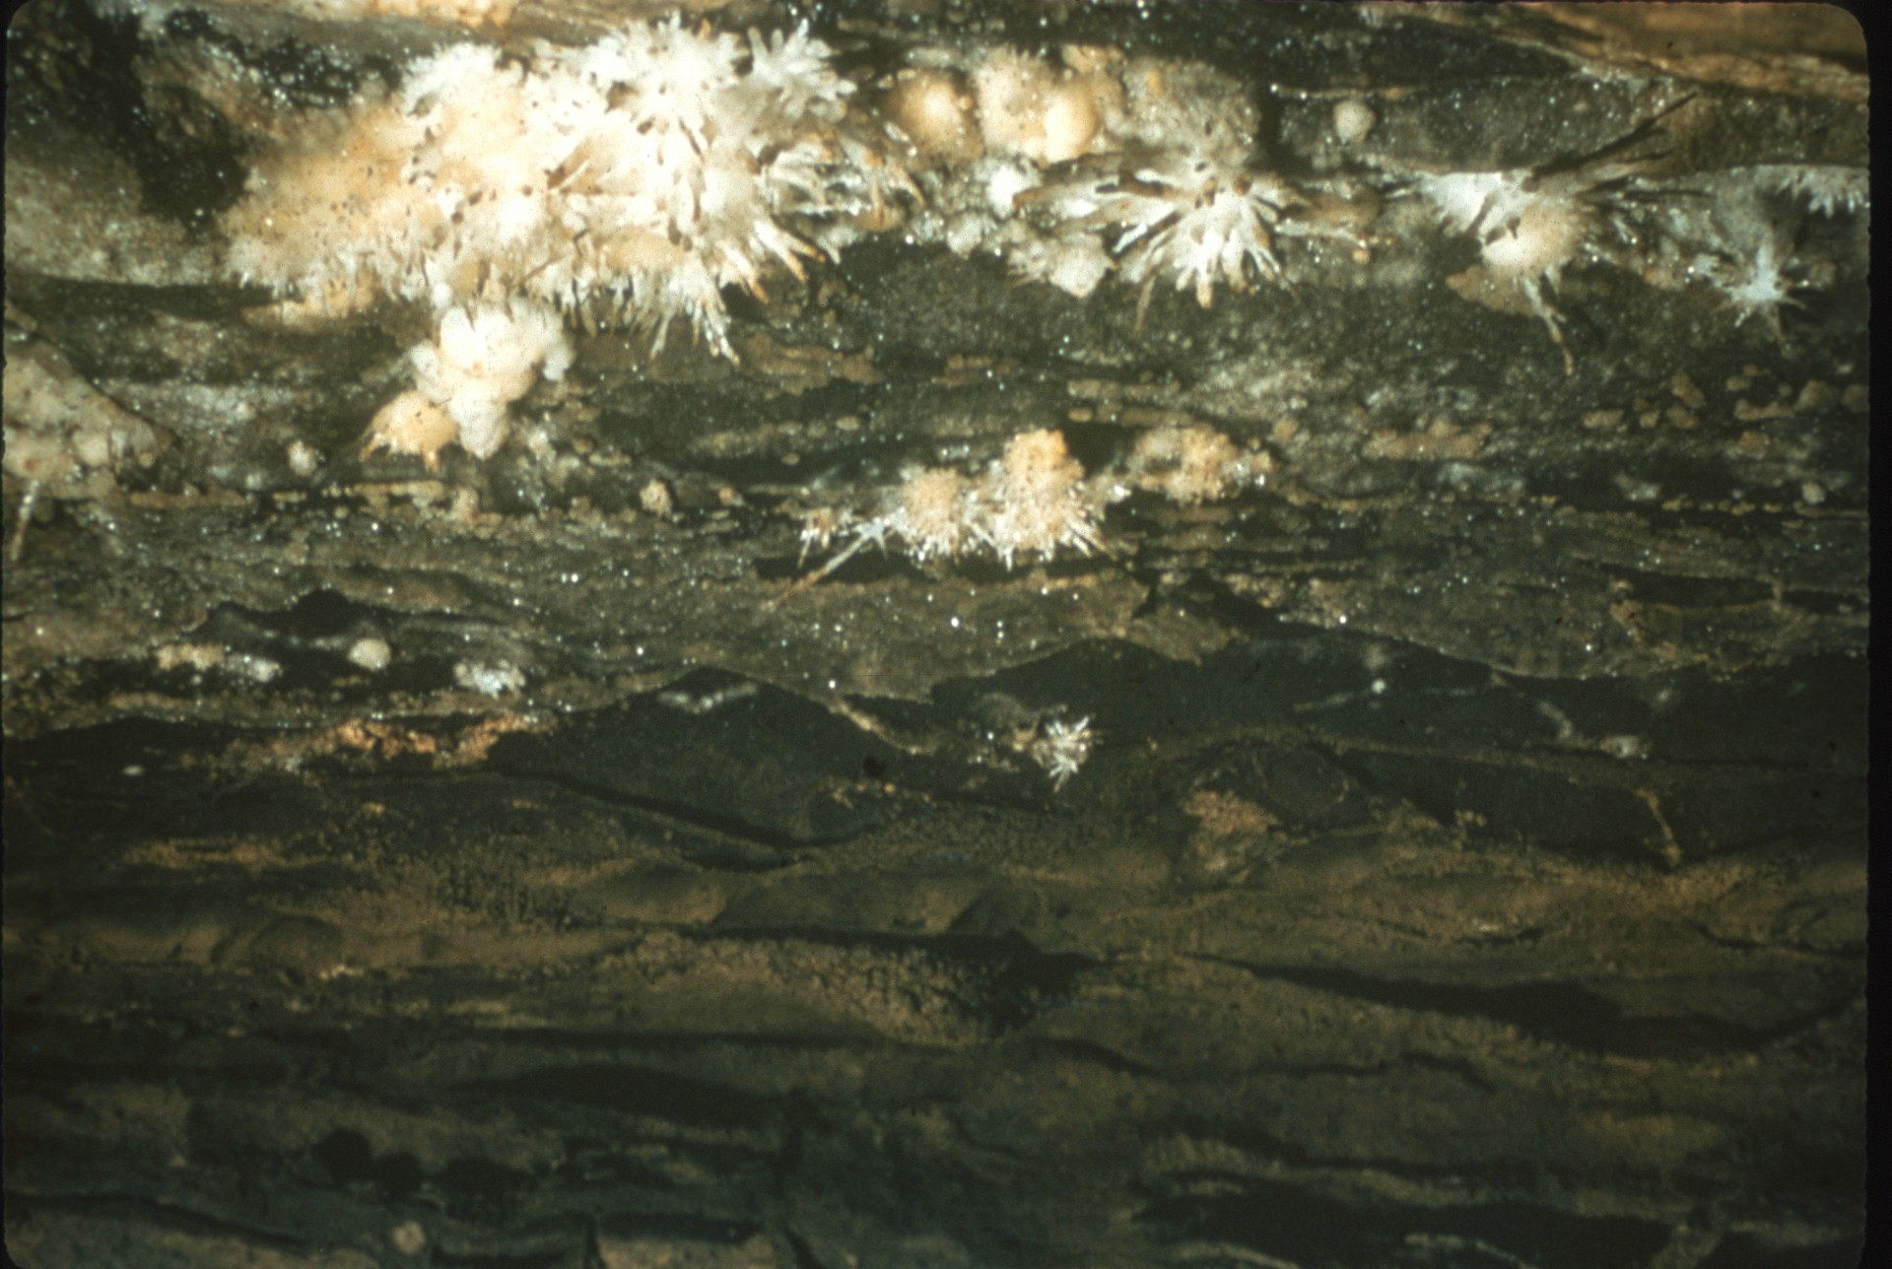
Notes:
Aragonite helictites sometimes have a beaded shape, with about ten beads to an inch. If the beads reflect an annual cycle, aragonite helictites grow rather rapidly, at an inch every ten years. There are beaded aragonite helictites in Cave of the Winds, Colorado, and in the New Mexican Room of Carlsbad Caverns. The specimens in this picture in Schofer’s Cave, Pennsylvania.

Slide 50
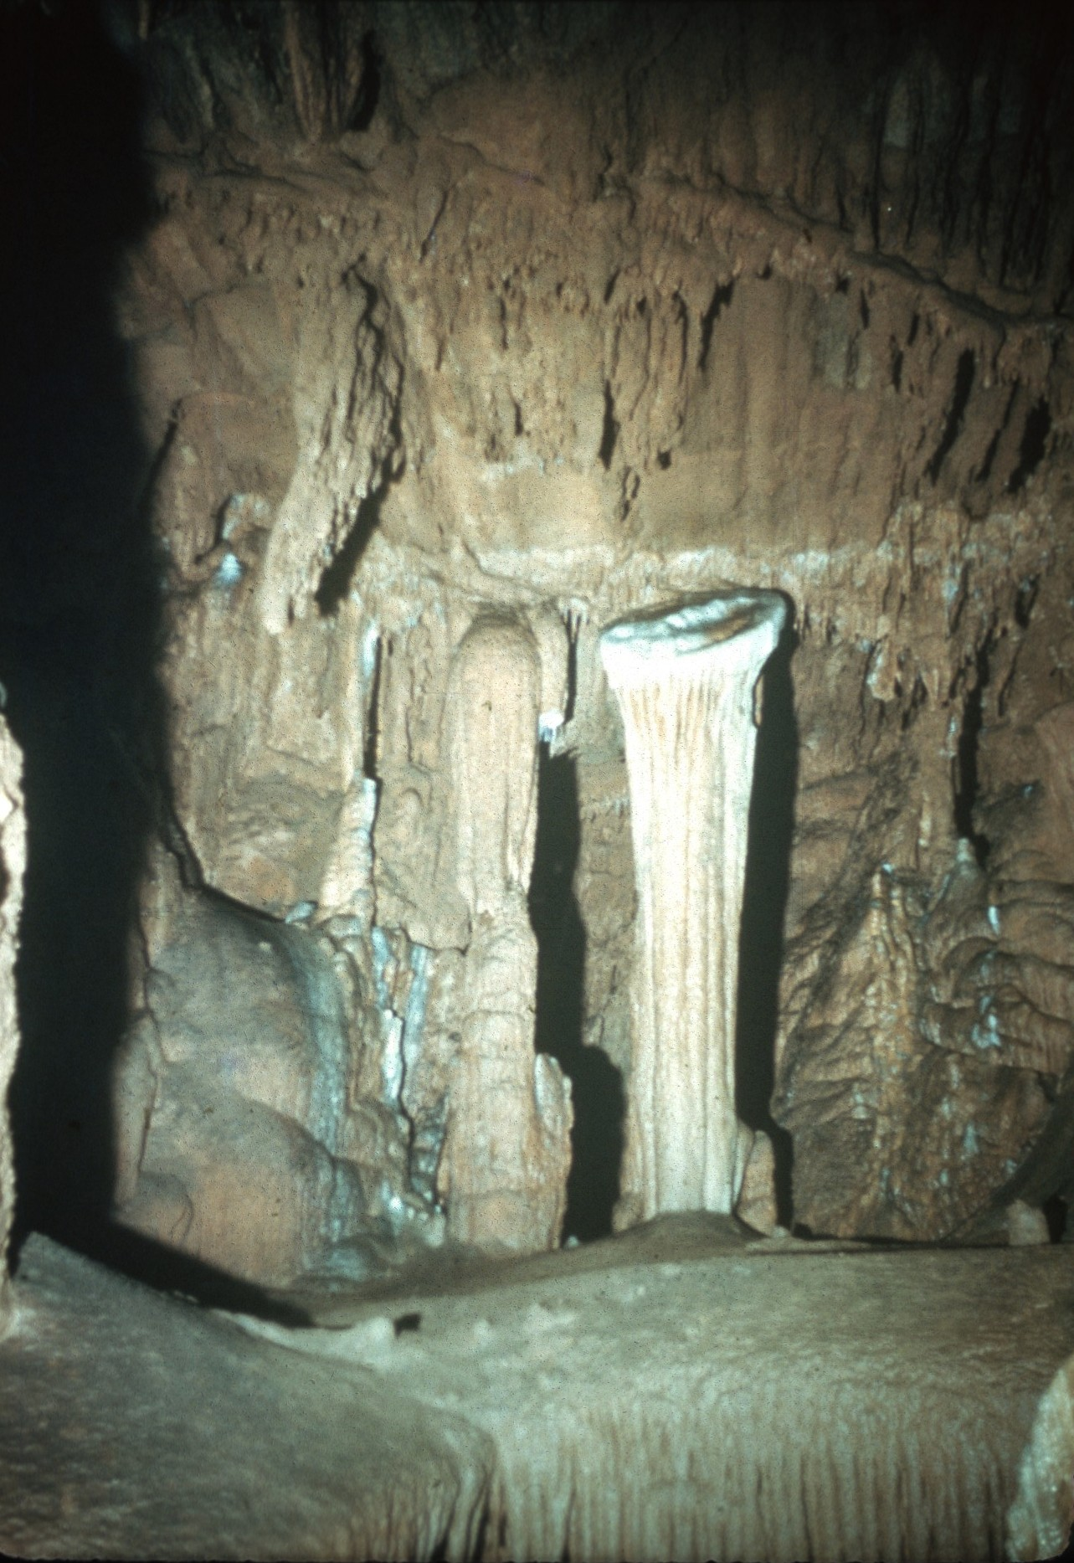
Notes:
Another speleothem formed by seeping water which is related to the origin to helictites is the SHIELD. Shields are disc-shaped structures averaging about an inch thick and several feet in diameter. They are attached at one edge to the ceiling, walls, or floor of a cave and project outward at an angle into the chamber. Commonly, stalactites and draperies hang downward from the rim of shields and often helictites form on their upper surfaces.

Slide 51
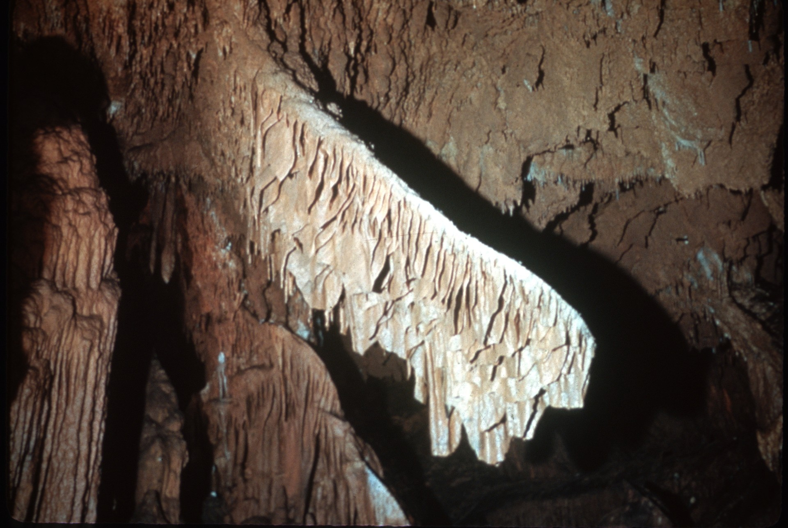
Notes:
The origin of shields has been learned only recently. The most commonly proposed early hypothesis of their origin was that they resulted when layers of travertine were deposited on beds of clay; if the clay was later washed away, unsupported projecting deposits like canopies remained.

Slide 52
Notes:
Another proposal suggests that shields are not speleothems at all, but veins of calcite filling cracks in the walls of the cave that were exposed and made to project when the cave was dissolved. The concept of origin of shields that we now accept was first suggested by Czechoslovakian speleologist Josef Kunsky.

Slide 53
Notes:
Shields have an upper and a lower plate, separated by a crack through which water can move. Sometimes, if the weight of stalactites on the lower plate becomes too great, this plate may fall away from the upper, allowing us to see the internal structure of the shield. Each plate is made up of concentric layers parallel with the other edge. Shields being as welts along cracks in the wall of a cave. As water seeps out through a crack, it deposits material outward in elongated bodies, and the crack is extended into the shield. Probably continued movement along the fracture maintains the crack in the speleothem.

Slide 54
Notes:
[Pause…] [The Bridal Veil, Grand Caverns, Virginia]

Slide 55
Notes:
One of the most common deposits in caves, CAVE CORAL, is thought to be formed by seeping water.

Slide 56
Notes:
This cave salamander [Eurycea lucifuga] is resting on some typical cave coral. The individual knobs are generally smooth and about a quarter to half an inch in diameter. They branch and often stand about an inch from the wall, but some may extend outward six inches or more in a delicate network.

Slide 57
Notes:
In cross-section, knobs of cave coral exhibit a concentric banded structure and usually they contain more coloring matter than other speleothems. The crystal arrangement is radial and perpendicular to the growth bands.

Slide 58
Notes:
Cave coral often occurs in places in the cave where it could not have received water from dripping or splashing. Yet some of these deposits have wet surfaces and appear to be growing. Cave coral commonly is more prominent along cracks in the wall or on porous deposits of cave fill, and in places, tubular stalactites form from the outward terminations. These facts suggest that cave coral is formed by seeping water, but thus far its exact mode of growth is unknown.

Slide 59
Notes:
Another curious cave deposit formed by seeping water is MOON MILK. Moon milk is a white, pulpy material found coating the walls of come caves. It has the unctuous texture of clay, but unlike clay, when it is squeeze, clear water is expelled. The texture is very fine grained, and the particles average about one ten-thousandth of an inch in diameter.

Slide 60
Notes:
Moon milk in most caves is calcite, but that in Carlsbad Caverns and certain other caves where magnesium is available in the cave water, is hydromagnesite. Moon milk is one of the few cave deposits for which we have positive evidence that microorganisms play a part in its genesis. When moon milk is dissolved in weak acid, the residue is found to contain the abundant remains of bacteria and algae.

Slide 61
Notes:
Another group of deposits formed by seeping water is those in which crystals are added to the structures at their points of attachment to the wall. CAVE FLOWERS are the most common example of this type. Most cave flowers are composed of gypsum, and they spring from the walls of the cave in curving fashion much like helictites. The principal difference between cave flowers and helictites is that flowers have longitudinal striations on their surfaces and possess no central canals.

Slide 62
Notes:
They generally average about two inches in length and commonly originate from a center so that they resemble the petals of a flower. Rarely—as in Mammoth Cave, Kentucky—they may stand more than a foot from the wall.

Slide 63
Notes:
The deposition of cave flowers does not take place at the free end, but rather at their bases. The crystals form in minute pores in the rock and then force their way out into the cave chamber. As the speleothems move out, much like toothpaste from a tube, growth is sometimes more rapid on one side than on the other, resulting in the delicate curved structure of cave flowers.

Slide 64
Notes:
CAVE BLISTERS are hollow, hemispherical deposits, similar to cave coral, that form on the walls of caves. They average about two inches in diameter, but may be as much as a foot in diameter. Within a thin shell, usually of gypsum, there is a powdery mixture of calcite and opal. It is thought that they form like cave flowers, and from an initial bug, crystals are extruded in a circle of ever-increasing circumference so as to produce a blister-shaped deposit.

Slide 65
Notes:
Speleothems formed on the surface of cave pools make up a very small part of all cave deposits, but they include some of the more interesting species. One of these is the CAVE BUBBLE—shown here in a pool in Geshute Cave, Nevada, that has evaporated to dryness after formation of the bubbles. Cave bubbles are up to a quarter of an inch in diameter, and have very thin, fragile walls, especially at the top. They form on the surface of rimstone pools, and evidently crystallization takes place around a bubble of air or carbon dioxide.

Slide 66
(Slide Missing)
Notes:
CAVE RAFTS are thin, floating films of calcite, associated with cave bubbles, that are held by surface tension on cave pools. As the rafts become thicker they sink to the bottom and new ones begin to form. Deposits of rafts more than a foot thick have been found on the floor of some cave pools.

Slide 67
Notes:
The last environment in which speleothems form is underwater in cave pools. It is in this environment that we find the best development of crystal faces on the cave minerals. Sometimes whole rooms of a cave may be filled with water, and calcite crystals slowly form on the walls.

Slide 68
Notes:
In time, these rooms may be turned into giant geodes, with large crystals projecting inward. The pyramid-shaped crystals shown here in Soldier’s Cave, California, are about an inch long. In some caves, crystals grow to more than eight inches long.

Slide 69
Notes:
In these slides, we have seen that speleothems grow in several environments in caves, and by several processes. Some facts have been given, but most of the questions remain unanswered.. The solution of each mystery reveals another, for caves are one of the few places on earth where we can see minerals that are still in the process of formation.

Slide 70
Notes:
[Note: This book is no longer available from the NSS] Perhaps one of the best volumes available, and in important addition to your speleological library, is the book entitled British Caving – An Introduction to Speleology. Sponsored by the Cave Research Group of Great Britain, it is the work of many distinguished figures in the world of speleology. Many of its well-illustrated, 468 pages are devoted to such subjects as Caves and Rocks; Caves and Landscape; Origin of Limestone Caves, Cave Formations and Deposits; Cave Physics; and much other valuable information. This book may be ordered through the NSS Secretary for $5.50.

Slide 71
An NSS Audio-Visual Library Presentation
Speleothems
Dr. George W. Moore
Original slide program S301
Slides digitized by David Caudle
PowerPoint program created by Jim McConkey
71 slides, with script in presenter notes
PowerPoint created 2/03/2021
National Speleological Society
6001 Pulaski Pike
Huntsville, AL 35810-1122
256- 852-1300
nss@caves.org
https://caves.org/

